Slide 1


Professional Development Week
President’s Address
Spring 2024

Slide 2
Numbers

Slide 3
Enrollment | AFTE
Unduplicated Headcount
AY21/22 = 16,399 students
AY22/23 = 17,377 students
Difference: 978 students

Slide 4
Retention By Ethnicity

Slide 5

Graduation
Degrees & Certificates
3,970 | 17/18
4,060 | 18/19
3,879 | 19/20
3,562 | 20/21
3,051 | 21/22
3,242 | 22/23*
*Includes 56 BSN/BAS degrees

Slide 6
Achieving HSI Designation

Slide 7
AY 22/23 Graduation Survey Takeaways
98%
95%

Slide 8
Graduation Survey – Adult Learners
Adult Learners Takeaways
The adult learners that responded to the AY2223 graduation survey indicated they would like to see more evening and weekend course offerings.
When asked to provide additional feedback about their experience at PPSC, a notable trend in adult learner responses was the outstanding support and guidance received from their instructors.
51%

Slide 9
Trend in Distance Education
More than ½ of PPSC students are enrolled in 1 or more online courses
As of Fall 2023
28% of students were enrolled exclusively in online courses.
23% of students were enrolled
in at least one but not all
online courses.
48% of students were not enrolled in any online courses.

Slide 10
Budget and Staffing

Slide 11

Budget
As we budget for next year we have to keep these items in mind:
The governor is recommending a 2.5% increase in the budget
for higher education.
Non-personnel operating costs (e.g. utilities, facilities, IT infrastructure)
are up 13% from last year.
Projecting Personnel Costs:
This year we're on track to spend 6% more on personnel costs
than we did last year.
Each 1% of salary increases equates to around $400,000 in total
compensation for both APT and Faculty.
For example, a 2.5% increase in salary equates to around $2.2 million
additional in total compensation.
Classified increases in salary equate to around $1.2M in total compensation.
Townhall in February to explain in further detail and answer questions.

Slide 12
8 Years of Staffing at PPSC
 | # of Full Time Instructional Staff | # of Part Time Instructional Staff | Instructional FTE | # of Full Time Non-Instructional Staff | # of Part Time Non-Instructional Staff | Non-Instructional FTE | Total FTE | Instructional FTE/ Total FTE (%)
Fall 2023 | 187 | 412 | 324 | 311 | 7 | 313 | 638 | 51%
Fall 2015 | 168 | 571 | 358 | 358 | 42 | 372 | 730 | 49%
Change | +19 | -159 | -34 | -47 | -35 | -59 | -93 | +2%
AY | APT | Classified | Total | % APT
2023 | 203 | 115 | 318 | 64%
2015 | 144 | 250 | 394 | 37%

Slide 13
Workforce Data

Slide 14
Instructional Services

Slide 15

Colorado Online Updates
“We are seeing a significant increase in online enrollment across the system. This has caused us to plan for a 30% enrollment increase for Spring so that we don’t have to add too many last minute additional sections.”
As of 12/22/23, PPSC has a total of 377 sections
for Spring 2024 (2nd most in the system)
  206 home sections
  168 pooled sections

Slide 16
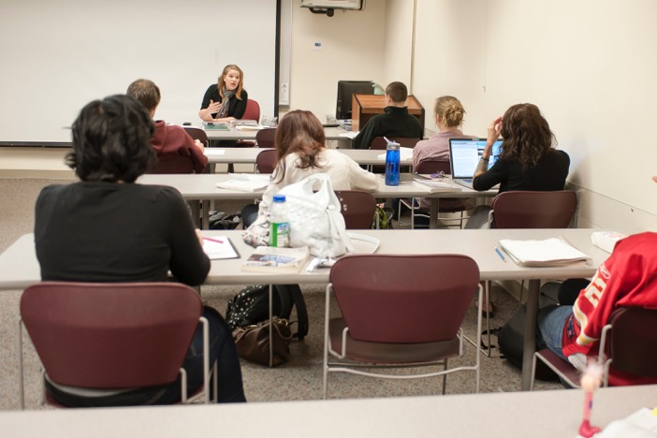
Reorganization
  All Executive Deans hired.
  Business, Technology and Public Service - Rob Hudson
  Technical and Professional Services - Heather Pierce
  Arts, Humanities and Social Sciences - Deidre Schoolcraft
  Science, Engineering and Math - Joyce Kaplan
  Health Sciences - Dr. Joseph Charleman
  The Campus Reorg Task Force is meeting in mid-January to assess next steps and maintain momentum. This work will intersect with the work of the Strategic Scheduling focus goal committee.

Slide 17

Care Forward/Career Advance
Care Forward
Total funds awarded: $3,671,681
Average Award: $3,853
953 Students Supported
All Care Forward funds have been awarded.
Career Advance
Total funds awarded: $681,515
Average Award: $2,534
269 Students Supported
Plan to continue providing funds through
Spring of 2025.

Slide 18
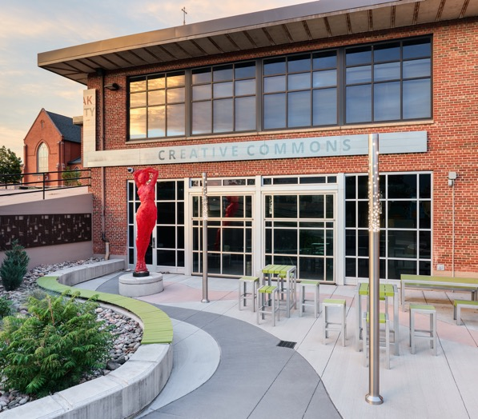
HLC 2025 Comprehensive Evaluation Visit
Scheduled in April 2025 (Year 10 of the accreditation cycle)
A five-member review team will be on campus for 1 ½ days
  Meetings with faculty, staff, students
Purpose: Determine whether PPSC is in compliance with
  HLC policies and assumed practices
  Five criteria for accreditation
  Federal regulations (e.g., disclosure of transfer policies,
  protection of student privacy)
Preparation: January 2024 – February 2025
  Update the 2019 Assurance Argument and Evidence File
  Update the 2024 Federal Compliance Report
  6-8 writers + campus-wide participation (share stories & evidence)
Notes:
Emphasize what does this mean for you?
It means that faculty and staff may be contacted by the writers to provide details and evidentiary documents. For instance, faculty may be asked to share their program review reports and evidence showing how they have used program review findings to improve their program. Library staff may be contacted to explain how they support students. Student life staff may be contacted to provide details on campus events,….

Slide 19

Community College Survey of Student Engagement (CCSSE)
National survey coordinated by the University of Texas' College of Education
Purpose: Elicit information on institutional practices and student behavior
  Active and Collaborative Learning
  Student Effort
  Student-Faculty Interaction
  Academic Challenges
  Support for Learners
Will be administered in a random sample of classes (about 90 sections) during the Spring semester
Faculty and Instructors whose classes are sampled will receive specific information as soon as PPSC receives the class sample (mid-February)
Survey results: will be sent to PPSC in August and used to update the HLC Assurance Argument

Slide 20
New & Upcoming Programs
Approved Programs:​
AAS Vet Tech
AAS Behavioral Health
In Development:
AAS Hospitality (Fall 2024)
BAS Cyber Security (Spring 2025)
BAS Education (Fall 2026)
BAS Business Administration (Spring 2025)
Dental Hygiene (Fall 2025)
Under Consideration:
Licensed Legal Practitioner certificate

Slide 21


CSU-Pueblo
Social Work Center
Sam Stevenson
Sociology starting Fall 2024

Slide 22
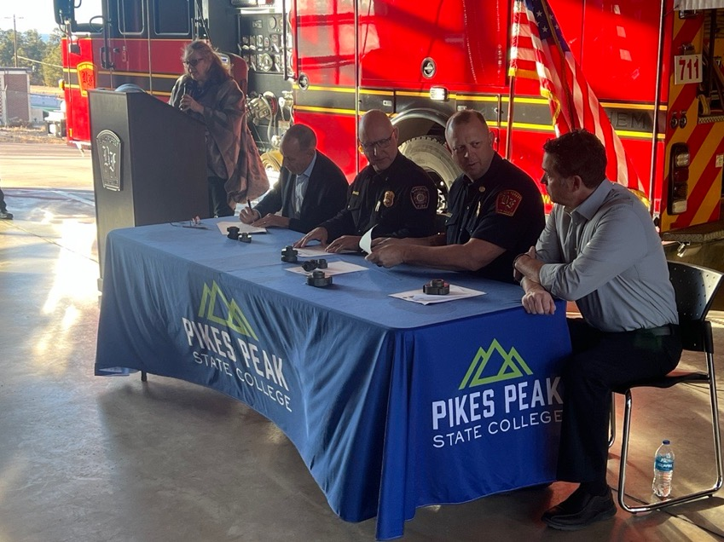
Partnerships
Black Forest Fire Rescue and
Monument Fire District
Peak Education
Engineering Transfer with UCCS

Slide 23
Promise Programs

Slide 24
Promise Programs - Dakota Promise Timeline
Dakota Promise
+76% from 2019
Harrison District 2 — First Cohort started Fall 2020
534 Dakota students served
Total number of D2 graduates enrolling at PPSC the Fall after
high school graduation.
534 students served by Dakota Promise from Fall 2020 to Fall 2023 census.
98
145
117
150
172
Fall 2019
Fall 2020
Fall 2021
Fall 2022
Fall 2023
Pre-DKP
1st Term of DKP

Slide 25
Fall 2022 to Fall 2023 Retention Rates
Dakota Promise Graduation Rate
54 Dakota Promise Scholars
have graduated, earning a
total of 65 credentials.
Of those 54 scholars, 15 have transferred out to another institution since graduating
from PPSC.
41%
69%

Slide 26
Dakota Promise Satisfaction
88%
92%

Slide 27

District 11 Promise
All D11 Schools are covered
Palmer High School
Doherty High School
Coronado High School
Mitchell High School
Hiring Promise coaches.

Slide 28
First Nations Scholarship Fund
The foundation, along with several other leaders from the college, and Dr. Bolton are working with Native American leaders to create a First Nations Scholarship.
This scholarship, when launched, will be available to Native American students in the Pikes Peak region of all ages.
We are still working on more details and hope to finalize this fund later this year,
in order to offer the scholarship beginning Fall 2024.

Slide 29
First Nations Promise
12,637 Native Americans
live in El Paso County, Colorado
High School Graduation Rates
Students living in El Paso County
27.9 % of N.A.
live in poverty
3,525 Native Americans have reported to living
in poverty in El Paso
County in 2023.
69%
56.6%
= ~500 people

Slide 30
Student Experience

Slide 31

Student Experience Staffing
Student Experience Division is hiring staff for the following vacancies:
Assistant to the VP and commencement coordinator
Director for Student Experience/Life
Director for Single Stop
  Then this director hires 3 student support specialists
Mental Health Counselor
Wellness and Fitness Coordinator

Slide 32



Student Assistance Fee
Student Assistance Fee budget that was approved will fund the following:
Mental Health Counselor position
  Bettermynd Contract
Single Stop Director Position
  2 student support specialists for Single Stop
  plus operational budget support
  1 student support specialist for Community Table
  plus operational budget support
There are also 3 “scholarship” categories that
will be distributed for the purposes of:
  Childcare, basic needs, and academic needs

Slide 33
Single Stop
PPSC’s SS program has been recognized as
one of the top five programs in the nation.
SS participants received over $5.9 million
in basic needs support through various governmental assistance programs.
In the 2022-23 academic year (AY), Single Stop (SS) awareness and utilization grew across our campuses. It surpassed its goal requirement of serving 200 students in the first two months of the grant cycle.
+300%
From AY 22/23
>200 students
In the first two months

Slide 34
Community Table & Mobile Food Markets
Community Table and Mobile Food Market Visitors
PPSC Community Table &
Mobile Food Markets
The Community Table and its affiliated Mobile Food Market have already distributed over 62,557 pounds of
food from January to November 2023
to its 4,408 visitors.
Funding for Single Stop and affiliated initiatives comes from The Foundation for Colorado Community Colleges (grant) as well as student fees.
AY 23/24 (so far)
16,325
Community Table Visitors
2,989
Mobile Food Market Visitors

Slide 35

The Counseling Center
The Counseling Center is hiring an additional counselor for PPSC.
Once the Counselor starts, we will have 2
full-time Counselors and 1 master level Intern.
Presentations in the classrooms and departments will resume in the Spring semester.
Students will go back to receiving up to 6 in person sessions with a counselor.
We will continue to provide events for mental health awareness for our students.
BetterMynd will continue to provide telehealth services
to our students.
Crisis services.
After-hours and weekend sessions.
Students will continue to receive 5 sessions
with a counselor.

Slide 36
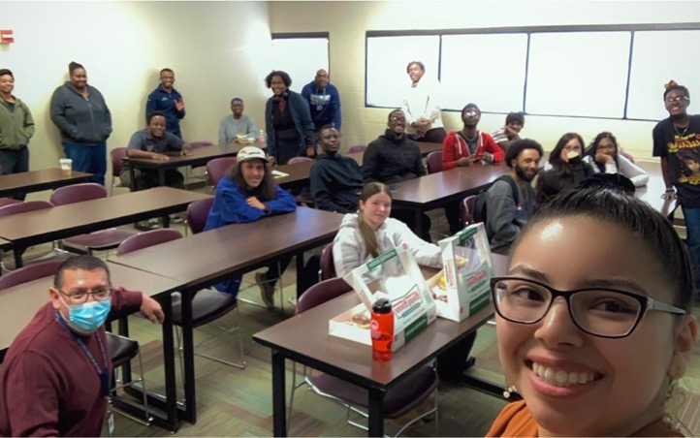
Student Experience/DEI Updates
Student clubs are re-emerging and gaining momentum and visibility
The LGBTQ+ Student Club and BSU have convened and are planning events, creating awareness, and strengthening their sense of pride and identity.

Slide 37
Strategic Plan

Slide 38
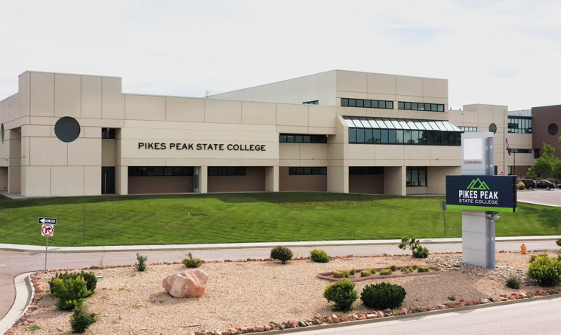
Focus Goals
We held a Focus Goal Townhall in November and there will be another one this March and each semester to update on progress.
Four Focus Goals
Strategic Scheduling
Adult Learners and the Adult Learner Task Force
Employee Engagement and Campus Culture
New Tuition Plan for PPSC Employees

Slide 39
Foundation

Slide 40
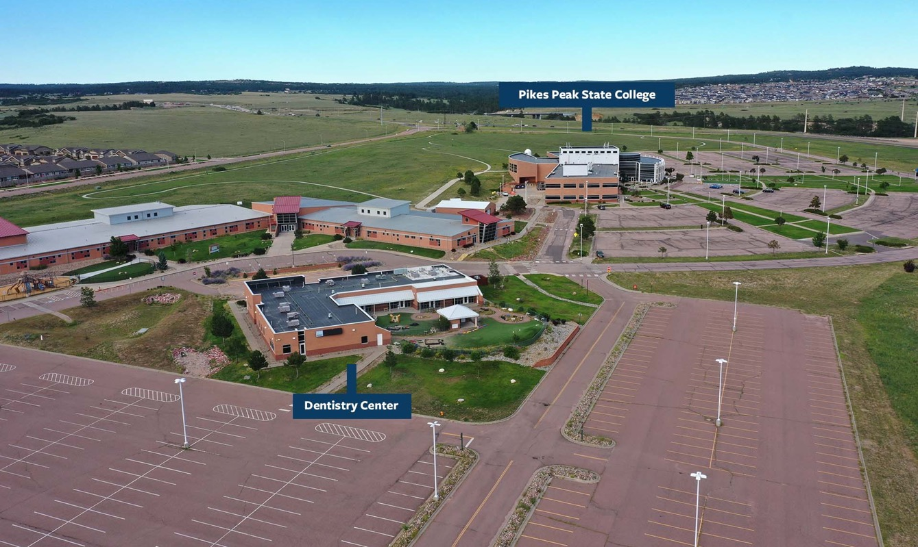
Delta Dental Center Update

Slide 41

Opportunity Now Grant
Opportunity Now Grant
PPSC was awarded a $47K planning grant to build a more robust, accessible and diverse engineering technician pathway.
The grant group has been working with industry and K-12 partners to assess current employment needs, trends in middle and high school STEM education and to refine PPSC’s ET curriculum.
We have applied for a much larger Opportunity Now Phase II grant. This grant will enable us to implement what we have learned during the planning grant cycle and create an on-campus Makerspace/Prototype lab. We expect to hear later in January about this grant award.

Slide 42

Thunderbird
We have received a donation of a 1955 Ford Thunderbird, the first year T-Birds were made.
Automotive students will detail the vehicle and the foundation will auction it.
The funds will be used for scholarships for students in the automotive program.

Slide 43
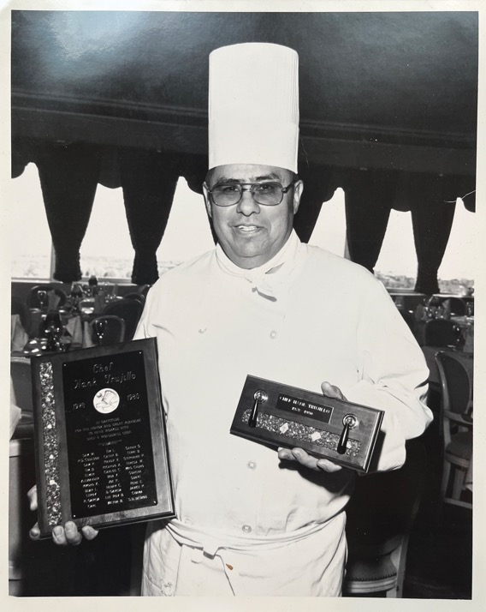
Trujillo Memorial Scholarship Dinner
The Chef Trujillo Memorial Scholarship Soiree is set for this Spring. It will be on Saturday, 9 March 2024, at the beautiful Broadmoor Hotel.
This special event will honor the legendary Chef Henry Trujillo, the Broadmoor’s 3rd Executive Chef and a mentor to many in the culinary department of PPSC.
Culinary students and staff will participate in this event and the funds raised will help to launch an endowment scholarship that will offer scholarships to culinary students for years to come.

Slide 44

Frank Macon Memorial Scholarship Endowment
In December, we launched the Frank Macon Memorial Scholarship endowment.
This endowment honors original Tuskegee Airman, Frank Macon, who lived in Colorado Springs until his passing in 2020.
Frank struggled with Dyslexia as a child and had a hard time getting a good education. He was brilliant, however when it came to engineering, mechanics, and figuring out how to build almost anything with his hands.
He wanted to create a scholarship for students with similar struggles who are studying to get certifications and/or a degree in the Trades industry.

Slide 45
Facilities & Operations

Slide 46

Wayfinding
Underway since August 2023. Initial feedback received in December.
Presentation set for faculty on Wednesday, January 12 at 2:00 p.m.
Next design iteration comes January 19.
Listening sessions week of January 29.
Finalize designs by March 1.
Phased implementation starting for Fall 2024.

Slide 47

Kudos
Faculty of the year: Billie Jo Giles
Instructor of the year: Carolyn Owen
APT of the year: Jack Grimm
Classified of the year: Parker Burgess
Mayor’s Young Leader Award: Matt Radcliffe
Military Gold Best for Vets
Alex Cone NCMPR Rising Star Award

Slide 48
Questions?

