Slide 1

Welcome to Professional Development Week
August 10-14, 2026
https://forms.cloud.microsoft/r/u8PrCmjvzN

Slide 2

Learner-Centered Teaching: Creating Classrooms Filled with Curiosity, Honesty, and Meaning-Making

Slide 3




Professional Development Week | President’s Address
PROFESSIONAL DEVELOPMENT WEEK
PRESIDENT’S ADDRESS FALL 2026

Slide 4
Culture Makes Strategy Possible
We put students at the center.
We take care of each other.
We never stop innovating.

Slide 5
Numbers

Slide 6
Enrollment | AFTE
Unduplicated Headcount
AY24/25 = 17,996 students
AY25/26 = 18,810 students
Difference: +814 students
Fall 2026:
FTE = 8,945.8

Slide 7
Achieving HSI Designation

Slide 8
Retention

Slide 9
Leading the System in Retention

Slide 10
Retention By Ethnicity

Slide 11
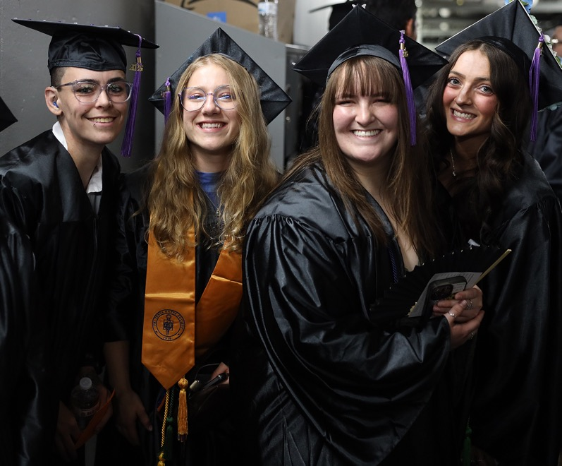
Graduation
Degrees & Certificates
3,562 | 20/21
3,051 | 21/22
3,242 | 22/23
3,256 | 23/24
3,229 | 24/25
5,289 | 25/26*
*Includes 98 BSN/BAS degrees
*Includes 2,052 auto-conferred credentials
PPSC offers 7 Bachelor’s Degrees
Bachelor of Applied Science
Advanced Paramedic Practitioner
Behavioral Health
Business Administration
Cybersecurity
Emergency Service Administration
Elementary Education
Bachelor of Science in Nursing
RN-BSN

Slide 12
Bachelor’s Degrees

Slide 13
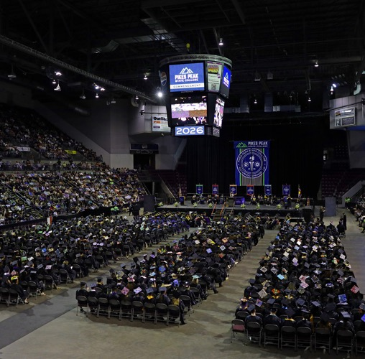
Commencement Stats
Students:
720
students walked
6,000+
came in person
2,454
watched the live stream
Gratitude to Volunteers:
Our Largest Ceremony Ever
90%
Graduates who said the volunteers were
helpful and check-in was smooth.

Slide 14

Budget and Reserves

Slide 15
Where Our Money Comes From
FY26
+$158,298
in our share of Budget
5% increase in
Tuition Rates

Slide 16
In Person vs Online Tuition Actual Revenue FY26
Resident and Non-Resident
Every 1% increase in Enrollment increases FY26
Tuition Revenue by $1,963,085
(includes 3.5% tuition rate
increase FY26)

Slide 17
Reserve Balance History

Slide 18
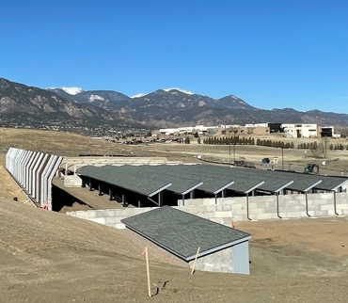
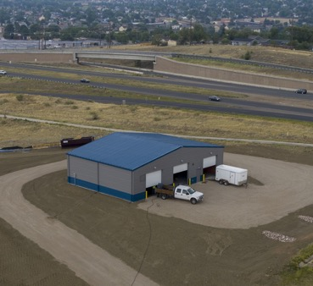
Capital Projects Completed in 25/26
Centennial
  Slope Mitigation at Firing Range
  CSPD Firing Range Improvements – $5,146,166*
  Fire Training Garage
  C Lot and Service Road
Downtown
  Replace Sewer Vent Pipes and Upgrade Restrooms
  Studio West Parking lot
Rampart
  RRC Chiller Replacement
  RRC Electrical & Emergency Generator
  RRR Repaving Ring Road and Parking Lots
Multiple
  Upgrade Interior and Exterior Signage
  Facilities Master Plan
Total: $12,038,391

Slide 19
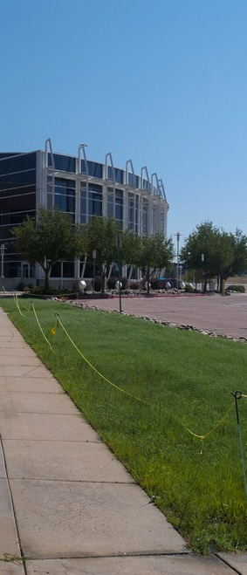
Facilities and RRR projects completed in 25/26
Centennial
  Roof replacement at firing range main building
  Marketing and Communications furniture and painting
  Practical Nursing, A360/363, refurbish of spaces
  SGA space refurbish
  ITSS Project - Theater Speakers
  B201 Renovation
CHES
  Sonography classroom remodel
Downtown
  Studio West exterior painting
  Landscaping project at West entrance
Rampart
  Turf to native grounds project. Partially grant funded
  Installation of automated door openers at W119 and West entrance
  Fitness center addition
  Flooring in S102
Multiple
  All campuses ongoing classroom/office paint/lighting/furniture

Slide 20
Capital Projects Planned for 26/27
Centennial
  Replace & Upgrade Fire Alarm System - Replace main panel and devices
  BAS & Chiller Replacement - Replace chiller #2 and building automation system
  Window Project - Replace some 2nd/3rd floor windows on north side of Aspen Building
  HR Office Renovation - Reconfigure HR nook to accommodate 3 new offices
CHES
  CHES Classroom Buildout - Convert commons area to 2 classrooms, add wall to 148/150, modify storage room
Downtown
  DT Music Rooms - Renovate performance space, create recording studio, and upgrade practice rooms
Rampart
  RRC E208 and 211 Remodel - Upgrade classrooms for engineering, computer, and print labs
  RRC Science Labs - Convert vacated dental classrooms to new science labs
  Replace and Upgrade Building Automation System - Replace all controls
  RRC Intersection Entrance & Exit Project
Multiple
  Wayfinding Phase 2 - Additional exterior signage
  Parking Lot Improvements, RRC & Firing Range - Replace pavement
Total: $19,044,754

Slide 21
RRR Facilities Project Investments planned
Centennial
  PTA Lab Shelving
  Dean of Students Office Enclosure – A104
  Division of Online Learning Expansion – A228
  ITSS Project - Learning Commons Sound System
CHES
  Medical Assistant Dirty Utility Lab
Downtown
  Downtown S205 S215 Door Partition Replacement
Rampart
  N202 Remodel
Multiple
  All Campuses ADA-Accessible Building Entries
  Facilities Audit - CC & RR
  Office Furniture RRR

Slide 22
Projects to be Initiated with Architectural and Design Plans
Centennial
  F-Building Remodel (Phase 1 – A&E (Architecture & Engineering)
  The Grove Renovation / Student Engagement Modernization (Phase 1 – A&E)
  Leadership Conference Rooms & Leadership Suite
  Campus Police Office Renovation
  Student Ambassador Workspace Modernization (Phase 1 – A&E)
Downtown
  Room N104 Renovation
  S210 Complex Renovation
Additionally Budgeted For FY27–FY28
  Wasson Health Sciences High School Location

Slide 23
Staffing

Slide 24
VPIS Search
Committee Determination: Early -Mid September
Post/Advertise: Mid-September
Committee Review of Candidates meeting minimums: Mid-October
Initial interviews: Late October
Campus visit/interviews/Meet and Greets: Early November
Candidate Selection mid-November
Start date: As soon as practicable

Slide 25
Compensation Plan
Numbers for compensation increases:
  CCCS Approved Compensation Increase: 3%
  PPSC Compensation Increase: 4%
    2% for those hired between April 1 and June 30, 2026
  Total Faculty and APT Adjustments from Increase: $1,165,501
  Faculty and APT Equity Adjustments: $287,134
  Classified Adjustments: $82,150.21
  Total Adjustments: $1,534,785.21

Slide 26
APT Title and Banner Class Transparency
Background
  Built from a desire for transparency and consistency in starting salary ranges
    Job Titles have different meanings depending on its area of the college
    Every Job Title has a CCCS assigned Banner Class Code
  Absolute minimum starting salary will never be below Colorado's Poverty Wage, currently $50,891
Tasks Completed by Human Resource Services
  Review APT job descriptions (approximately 300)
  Ensure positions are categorized properly by aligning minimum qualifications with their CCCS Banner class code definitions.
    Minimum qualifications include education and experience, complexity, impact on organization, working conditions, supervisory responsibility, and decision making.
  Note: Any change in categorization from this work did not change anyone's current salary.

Slide 27
APT Banner Class Codes
Academic Support
  Academic Support Professional: ASP (Level 1-5)
  Academic Support Professional, Senior: APSR (Level 1 only)
  Academic Support Professional, Supervisor: ASPSV (Levels 1-3)
Business Support
  Business Support Professional: BP (Level 1-5)
  Business Support Professional, Senior: BPSR (Level 1 only)
  Business Support Professional, Supervisor: BPSV (Levels 1-4)
Information Technology
  Information Technology Professional: ITP (Levels 1-6)
  Information Technology Professional, Senior: ITSR (Level 1 only)
  Information Technology Professional, Supervisor: ITSV (Level 1 only)
Library Professional: LIBR (Levels 1 & 2)
Director
  Director 1: DIR1 (Levels 1 & 2 and FAC)
  Director 2: DIR2 (Levels 1 & 2)
  Director 3: DIR3 (Level 1 only)
Executive Dean: DEAN (Level 1 only)
Associate Dean: ASDN (Level 1 only)
Associate Vice President: AVPS (Level 1 only)
Vice President: VPRES (Level 1 only)
By 8/17 documentation will be available in the Human Resource Services Card in the MyPikesPeak Portal including:
APT Banner Class Code Definitions
APT Titles assigned to Banner Class Codes

Slide 28
Coaching for Professional Growth
Minimum 3 coaching sessions per year
Initial Trainings Scheduled on each campus
  Various dates 8/18 – 9/1
  Invites coming from HRS
Additional trainings will be scheduled for Departments and Divisions
Feedback Form:
  Emailed to everyone today along with the training schedule
  Available in HRS Portal Card once electronic version is debugged
Thank you to the Implementation Team for their work in Spring and Summer semesters.

Slide 29
Grants at PPSC

Slide 30

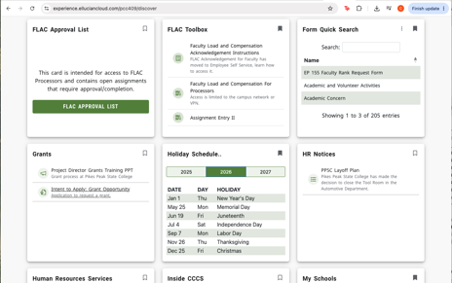
Intent to Apply for Grant Opportunity
Complete Project Director Grants Training
Submit the form
All found in the Grants card in the portal

Slide 31
Promise Programs

Slide 32

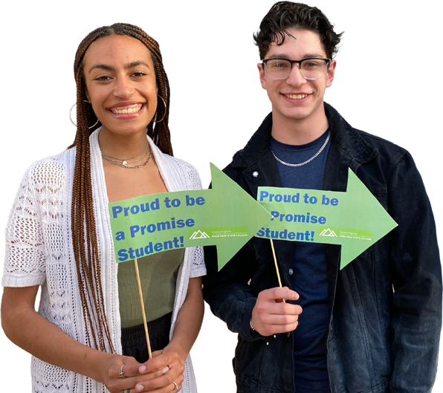
Enrollment & Reach
The 2025-2026 academic year had 551 new Promise students, the highest since the program’s inception.
We have surpassed 1400+ students served by the Promise Programs team since fall 2020.
Orientation Success: 390 students attended Promise Welcome Orientations this summer.
  D2: 186
  D11: 204

Slide 33
Retention Improvement
*Promise Student groups include a mix of new and continuing students.

Slide 34

First Nations Promise
Current Semester Enrollment: 52 scholars continuing from AY2526 enrolled for the Fall semester and 20 new scholars expected to enroll for Fall 2026.
Total Enrollment Since Program Start: 78 students served through Spring 2026, with 20 new students expected in Fall 2026.
Success: 65% of all scholars served have graduated, transferred, or are still enrolled at PPSC.

Slide 35

District 11 Promise
Total Enrollment since program start: 473 students served through Spring 2026, with 204 new students expected in Fall 2026.
Retention:
Fall 2024 to Fall 2025 = 76%
Success: 84% of all scholars served have graduated, transferred, or are still enrolled at PPSC.

Slide 36

District 2 Promise
Current Semester Enrollment: 256 scholars continuing from AY2526 enrolled for the Fall semester with 186 new students expected to enroll for Fall 2026.
Total Enrollment since program start: 922 students served through Spring 2026, with 186 new students expected in Fall 2026.
Retention:
Fall 2024 to Fall 2025 = 77%
Success: 66% of all scholars served have graduated, transferred, or are still enrolled at PPSC.

Slide 37
Instructional Services

Slide 38
Concurrent Enrollment 5-Year Trend
Unduplicated Headcount | 2020–2021 | 2021–2022 | 2022–2023 | 2023–2024 | 2024–2025 | 2025 –2026
High School Student Headcount | 3240 | 2965 | 3402 | 3790 | 3680 | 3950
Total Headcount | 17519 | 16399 | 17377 | 17739 | 17996 | 18810
% High School Student | 18% | 18% | 20% | 21% | 20% | 21%
Student FTE | 2020–2021 | 2021–2022 | 2022–2023 | 2023–2024 | 2024–2025 | 2025 –2026
High School Student FTE | 1443.0 | 1292.2 | 1375.0 | 1517.9 | 1534.9 | 1551.2
Total FTE | 8282.7 | 7615.7 | 7950.7 | 8223.7 | 8526.5 | 8945.8
% High School Student FTE | 18% | 17% | 17% | 18% | 18% | 17%

Slide 39
Online Learning
691
Total Sections

Slide 40

AI
Year One at a Glance The first twelve months, in numbers
PROMPTS SENT
185,742
Across 25,615 chats. An average of 517 prompts every day
of the year.
PEOPLE WITH ACCESS
3,519
Students, faculty and staff holding a BoodleBox account, of whom 2,034 have actively engaged.
WORDS GENERATED
96.9 M
Plus 10,814 images across coursework and instruction.
DOCUMENTS UPLOADED
30,412
Grounding 45% of all prompts
in real source material.
ASSISTANTS USED
592
Frontier models, prebuilt helpers and Pikes Peak-built bots.
AI MODELS REACHED
59
No single-vendor bet. Anthropic, OpenAI, Google, Perplexity and more.
PARTNERSHIP
One Fantastic Partnership
Pikes Peak and BoodleBox building together.
Measured August 2025 through August 2026 across every member of Pikes Peak’s BoodleBox team, current and removed.

Slide 41
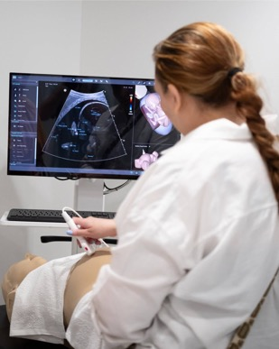

New & Upcoming Programs
Enrolling Now:
Elementary Education, BAS
Diagnostic Medical Sonography
CNC Machining Certificate
In Development:
Special Education, BAS
Healthcare Administration, BAS
Diagnostic Medical Sonography, BAS

Slide 42
Student Experience & Equity

Slide 43

Single Stop – 5 Year Summary
2,778
total participants
11,677
referrals made to on-campus and community resources
145,637
food pantries visitors across campuses
#1 Program in Colorado, Fifth consecutive year
20,313
mobile food market visitors
$42.1 M
in benefit assistance

Slide 44
Strategic Plan

Slide 45
PPSC Strategic Plan
The Halfway Point
TIME TO REFLECT, CELEBRATE, AND REFINE.
2023
2026
TODAY
↑
HALFWAY POINT
2030
VISION
START

Slide 46
Strategic Plan | Accomplishments
Our Progress: 2023–2026
Overall Course
Pass Rate
77.9% → 83.3%
Fall to Fall
Retention Rate
49.2% → 58%
Three-Year
Graduation Rate
22.9% → 25.0%
Key Accomplishments
Launched Strategic Scheduling
Increased PLA Utilization
Achieved HSI
Status
Broadened Employee Educational Assistance
Expanded Professional Development

Slide 47
Strategic Plan | One Direction
CCCS STRATEGIC GOALS: 5 YEARS | 2025–2030
Economic Mobility
↓
Education for All
↓
Empowered Talent
↓
Partner of Choice
↓
Power of 13
↓
PPSC STRATEGIC PRIORITIES: 5–7 YEARS | EXTENDED TO 2030
Agility in Industry Needs & Regional and Economic Workforce
First Semester Student Success
& Retention
Create a Thriving and Energizing Employee Environment
Inclusive Excellence & Equity
Weave equity and inclusion into every priority to drive meaningful outcomes for students, employees and our communities.

Slide 48
Strategic Plan | Actionable Steps
 | SMART Goals
 | Program vitality & alignment
 | Bachelor’s degree enrollment
 | Total headcount
 | Student retention
 | Employee retention
 | Completed by December 2027
 | Focus Goals
 | Student retention
 | Employee onboarding & professional development
 | Workforce development
 | 1 – 2 years
 | Special Projects & Initiatives
 | Emerging Opportunities AdvanceEDU Project Greenhouse Etc.
 | Flexible Adaptable to changing needs

Slide 49

Strategic Plan | What we are Hearing
Embed Inclusive Excellence Across Our Work
Grow Workforce & Employer Partnerships
Advance Our Use of AI & Emerging Technologies
Update Facilities & Create Collaborative Spaces
Strengthen Employee Connection & Growth Opportunities

Slide 50
Enhancing the PPSC Experience

Slide 51
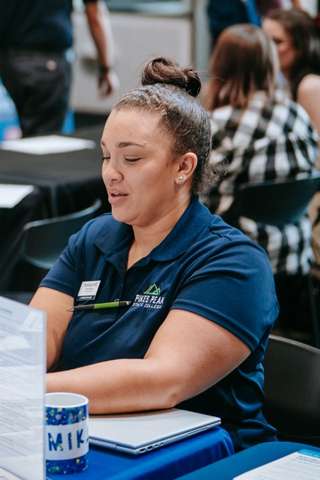
Employee Apparel
  Eligible employees receive up to $70 in college-funded apparel each fiscal year.
  Talk to your supervisor to order

Slide 52
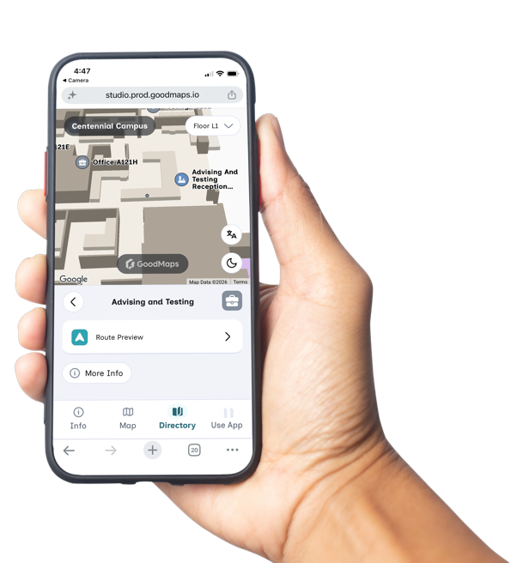

Wayfinding
GoodMaps: Accessible Navigation
Free turn-by-turn navigation helps every student find their way.
Accessibility-first design.
Easier navigation reduces friction before students reach the classroom.
PPSC is leading with access, dignity, and student-centered technology.
Demo on Thursday, 2–3pm Matt sent an invite.
See how they work:
pikespeak.edu/maps

Slide 53
Questions?

Slide 54
Kudos

Slide 55




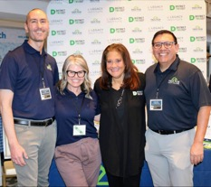



Kudos – College-Wide Success
Bellwether Award Finalist and Bellwether Award for Best in Showcase (Workforce Development Category)
Colorado Basic Needs Campus Designation (Colorado Department of Higher Education)
From Insight into Academia: Top Colleges for Innovation Award (2026)
From Insight into Academia: HEED Award 2025 (Higher Education Excellence and Distinction)
Insight into Academia 2025 and 2026 (for 2026 there is a press embargo until August 6, 2026, FYI): Excellence in Mental Health and Well-Being Award
First Generation-Serving Institution Designation from the Colorado Department of Higher Education (2026)
9 regional NCMPR Medallions and 1 national NCMPR Paragon Award for marketing
Military Friendly School (Silver Distinction) 2025
Military Times Best for Vets Colleges
Military Times Best for Vets Employers
Military Friendly Spouses Distinction (2025)
Colorado Qualified Apprenticeship Intermediary (Industry and Talent)
Bellwether Award Finalists

Slide 56
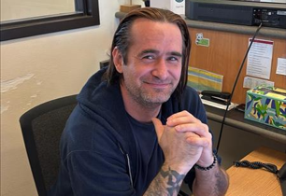
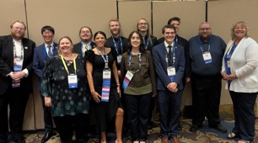
Kudos – Student Success
Student Employee of the Year award: Mr. Michael Burth, PPSC Zoology Student, is a VA Work-study and also works for MVP as a part time School Certifying Official helping ensure benefits get to students.
Students that represented PPSC at FBLA National Conference- Amanda Darnell,
Noah Giles, Nick Jacobs, Youngjin Kim, Bryce Kindall, Gavin Knotts, Natasha Polombo, Elias Roa, Tatum Rood, & Jayden Rood.
  Here are the results for PPSC in the FBLA National Competition:
    Foundations of Technology: 1st - Elias Roa, 8th - Tatum Rood, 9th - Jayden Rood
    Business Ethics Case Competition: 9th place - Noah Giles, Youngjin Kim & Gavin Knotts
    Impromptu Speaking: 6th - Bryce Kindall
    Foundations of Entrepreneurship: 1st - Bryce Kindall
    Cybersecurity: 2nd - Elias Roa
    Foundations of Digital Design: 8th - Youngjin Kim
Michael Burth
FBLA National Competition

Slide 57
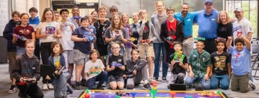
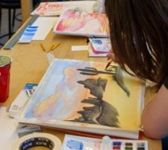
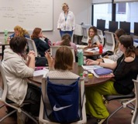
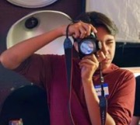
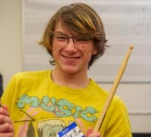
Kudos – Program Success
Summer Camps
  AHSS Summer Camp
  Robotics Camp: TPS hosted their second annual XRP Summer Camps designed to introduce and inspire middle school students to explore STEM career pathways. Students experienced hands-on building and coding robots and were fully funded by local sponsors!
  Healthcare Summer Camp completed two sessions, one in June and one in July. Enrollment for each week of summer camp was 40 students. Students completed two certifications each week of summer camp, rotated through Health Sciences programs to gain an in-depth perspective of the professions available, and were hosted by CommonSpirit one day.
EMS team on a Job well done on CAAHEP Continuing Accreditation through 2031 for the Associate of Applied Science in Emergency Medical Services-Paramedic and Paramedic Certificate Programs
First cohort of LPNs had their pinning ceremony on August 6.
The Project Space soft launch will happen in the fall! Designed for students in Technical and Professional Studies programs, The Project Space is a makerspace where ideas become hands-on projects and skills become career-ready experience
Robotics Camp
AHSS Summer Arts Camp
Watercolor
Creative Writing
Photography
Drumming

Slide 58


Kudos – Program Success Cont.
Remote Area Medical free medical clinic August 1st and 2nd. Free dental care, eye exams, medical exams, vaccinations, physical therapy assessments, and more! We can send over additional statistics once the clinic has run with the number of patients seen.
Dental Hygiene accepted their second cohort.
CHES will be hosting CU Anschutz medical students in Fall 2026 to participate in a surgical simulation in the OR suites.
In Spring 2026, the EMS department hosted Plains to Peaks RETAC at CHES to provide training for their Community Paramedic and Critical Care Paramedic courses.

Slide 59
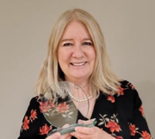
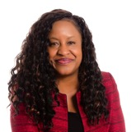
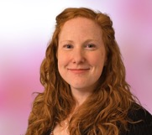
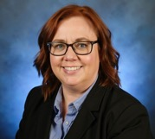
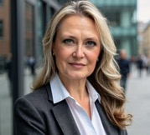
Kudos – Faculty/Staff Success
Kathie Keel, an Enrollment Services Specialist from DARES was recognized in May by CU Boulder as the Outstanding Colorado Community College Educator for 2026.
Donna Nelson: finalist for the inaugural Non-Profit Leader of the Year given by the Southern Colorado Women’s Chamber of Commerce.
Katie Wheeler
  2026 ITC Outstanding Pedagogy Media ~ for the 2025 ITC Spring Summit Collaboration with PPSC (sponsored by Respondus); Austin, TX; March 2026
  2026 BoodleBox Instructor of the Year ~ presented at the Teaching and Learning with AI conference in Orlando, FL; June 2026
  Appointed Co-Chair of the ITC AI Affinity & Emerging Technologies Committee
Christine Gaccetta-Sharp
  Elected Tri-chair of the CCCS Learning Design Community of Practice to replace Cynthia Krutsinger who stepped down after 3 years.
Cynthia Krutsinger
  Elected Chair-elect of the Instructional Technology Council.
Kathie Keel
Donna Nelson
Katie Wheeler
Christine Gaccetta-Sharp
Cynthia Krutsinger

Slide 60
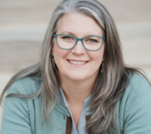
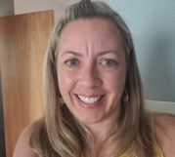
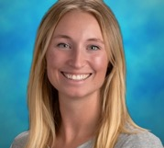
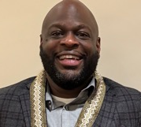
Kudos – Faculty/Staff Success Cont.
Betsy Tuma, Interim Associate Dean for TPS will be presenting at the Conference on AI and Higher Education and EDUCAUSE Annual Conference on the Curiosity over Mastery Framework and Replacing Discussion Posts with AI Bot Conversation.
Congratulations to Dr. Randee Nyman and the RN-BSN team for a very successful accreditation site visit in the Spring of 2026. The final report indicated no significant findings.
Congratulations to Sarah Yankowski for her presentation at the Nurse Educators Conference in the Rockies.
  Her work around Community Health and addressing Social Determinants of Health with Nursing students has been instrumental in raising awareness of needs in our communities.
Rotimi Ariyo, Downtown Campus Engagement & Events Manager, was honored with the GAWAD PASASALAMAT Award recognizing Pikes Peak State College Downtown Campus as Community Partner of the Year. Philippine American Chamber of Commerce of Southern Colorado (PACCSOCO). He was also recently selected to serve on the Board of Directors for the Foundation for Advancement and Education (FAE), a Colorado nonprofit organization that supports students and adult learners through scholarships, educational programs, and professional development opportunities.
Betsy Tuma
Dr. Randee Nyman
Sarah Yankowski
Rotimi Ariyo

Slide 61
Student Graduation Feedback to Specific Professors
Chef Heidi Block and chef Mark Painter! Both amazing people that helped me learn and plan my future.
Carol Kurkowski is someone who I would like to recognize. She made me feel celebrated, and that I have someone rooting for me and supporting me.
Photography dept. Casey and Cynthia
I would like to thank Marcia for her support, patience, and encouragement throughout the Pharmacy Technician program. As an English language learner, her help and guidance made a big difference in my success. I am very grateful for everything she did to help me reach my goal.
Dr. Carol Kurkowski was engaging and made the Business classes fun to be a part of. Dr. Stephen Collins challenged me to become a better public speaker and helped me gain confidence in myself.
To Joni Cunningham and Elizabeth Ann Coelho, thank you for the class and the cool stuff
Kristi Ramey!

Slide 62
Student Graduation Feedback to Specific Professors – pg 2
Professor Silva Miller - Was a very kind and attentive instructor who made me feel welcome during my last in-person semester. I really appreciated the intellectual engagement their course had to offer and our numerous chats before and after class. I appreciated having lively discussions in class as we looked more into the different structures for presenting information and that we did not shy away from difficult topics. Professor Melinda Mingo - provided me with an opportunity to really start to pick apart my life and create a roadmap for how to be happy in her interpersonal communications course. She cultivated an open and engaging learning environment where I truly felt comfortable and open around my classmates by the end of the semester. I cannot overstate how beneficial her course was as general education; I think I will reap the rewards in my professional AND personal relationships for many years to come. Professor Glen Rohlfing - was one of the first professors that I had the pleasure of interacting with in person. I initially sought him out when I was taking his online History of Science and Technology simply because most of my professors until then were inaccessible to me. We built a really great rapport and he was one of the first people to recognize my potential as a student and academian and give me gentle nudges to shoot for the stars. That commitment to helping students nurture their potential and eventually flourish embodies one of the most important qualities of a good educator in my mind. It was instructors like that throughout my life that helped me not give up on my dream of being a scientist and Glen embodies that trait.

Slide 63
Student Graduation Feedback to Specific Professors – pg 3
Dr Kurkowski
I would love to thank Sarah Sheppard Shaver for all of her patience and understanding! I couldn't have made it without her help! And all my instructors who were so understanding with me and helped me throughout my journey!
Focused on Career Preparation and Encouragement A huge thank you to Neil Everingham, Neil Austin, Dave Bullard and Kathleen Stempeck for always pushing me to reach my full potential. Your real-world insights, encouragement, and practical advice gave me the confidence I needed to pursue my career goals. I am incredibly grateful for the impact you’ve had on my professional development and future. Focused on Support from a Staff Member or Advisor I would like to recognize Nate Wadman and Nathan Roskop for their unwavering support and help behind the scenes. Navigating degree requirements, schedules, and deadlines can be overwhelming, but their patience and positive attitude always made the process seamless. Thank you for keeping me on track and always being a reliable resource.

Slide 64
Student Graduation Feedback to Specific Professors – pg 4
Dre Guy!!! I still have one more class to take so I have at least 2 more meetings with him but he has helped me so much over the course of my college experience and I am so grateful for him
Professor Lilika Belet for going the "extra mile" for her students, and not just doing what was required as an instructor. The Accessibility Services Team who ensured my special accommodations were met with a smile and sincerity. 🥰🙏🏾
Professor Diedre! (Environmental science) and Jennifer Holmes. Diedre was very helpful and allowed me to go to the restroom. And Jen greeted me with open arms after I got off stage (she’s also my best friends mom).
To the music department, Gayle Grace, Shazia, Carla, everyone in the choir, everyone in the orchestra, to be able to participate in the choir and all who played the music for graduation. the speakers as well for all that was said and for all the support.
Kris Akse was a great photography teacher.
I will always remember and be thankful for Tim Buchanan, Dennis Natali, Gwen Wallen-Sena, Carol Kurkowski, and Emily Forand for truly cultivating in me a desire to learn and become a better student and member of the future.

Slide 65
Student Graduation Feedback to Specific Professors – pg 5
I want to express my heartfelt gratitude to Brenda Cordova( VET department), the head of the veterinary science lab program. Her influence has profoundly transformed my perspective, encouraging me to think creatively, believe in myself, and trust my instincts. She set an exceptional standard in the classroom, and I will always be thankful for the impact she has had on my personal and professional growth. Patricia Forest VET department; has been instrumental in managing the vet program, and I cannot express enough gratitude for her contributions. She turned what I once thought was an unattainable dream into a reality, and I am incredibly thankful for her patience and the joy she infused into the classroom. Her passion for working with animals and her ability to share real-life experiences made a significant impact. She consistently encouraged every student to strive for their best, which is precisely the quality I value in a teacher. Patricia provided me with the support I needed to succeed, always available to answer my questions and uplift me during moments of self-doubt. She truly stands out as one of the best teachers I have ever had. Joyce Kaplan, Dean of the SEM, I want to express my gratitude for all the behind-the-scenes efforts you've made to help shape my future. Your dedication has truly made a difference in my life. Although our interaction on graduation day was brief, it was meaningful to see you. Thank you for everything you do; I genuinely appreciate it! I want to express my heartfelt gratitude to the Enrollment Services team, as their support was crucial in navigating the college system. They were always ready to assist with phone inquiries, paperwork, and technical issues with my portal. They even updated the website for snow days and other weather-related announcements, handling a multitude of tasks with efficiency. Without their help, I wouldn't be where I am today. The joy they shared when I picked up my certificate from the Enrollment Service Desk truly made that moment unforgettable. I want to extend my heartfelt appreciation to Brian for his invaluable assistance with the commencement ceremony. His support made a significant difference, and I can't imagine how it would have turned out without him. He handled over 25 of my phone calls and emails, always responding promptly and at convenient times. I am truly grateful for his dedication and help. I want to express my gratitude to the janitors and help desk staff across the rampart range and Centennial campus. Their hard work in keeping the campus clean goes unnoticed, but I truly appreciate their efforts. I’ve seen them diligently cleaning at 8:45 PM while students are still in class, and it’s clear that they play a vital role in making the college function smoothly. Thank you for all that you do behind the scenes. Love you Pikes Peak State College and thank you for making a dream become a reality!!!!! CLASS OF 2026

Slide 66
Student Graduation Feedback to Specific Professors – pg 6
I feel immense thankfulness to Ivana Seligova, Joe Gasteiger, McKenna Lovejoy, and Cindy Skaggs for their immense support and love for their subjects, and the endless support they gave me to pursue my dreams. I would also like to thank Dale Whitby for being my first in-person college professor and for providing a wonderful class.
Jesse Dorman
Emily Acevedo and Laura Quinn
COSI Coach Fern - without her I wouldn't have been able to do this.
Abbey Mobolade
Karen Phalen and Annie Anderson in the nursing department were two of the best instructors I've ever had.
Dorthi Roth is an amazing instructor and I think anyone would be blessed to have her as a professor
Michael Merson
All of them.

Slide 67
Student Graduation Feedback to Specific Professors – pg 7
I'd like to thank Chef Hino, Chef Block, Chef Paradiso, Chef Carpenter, Chef Diaz and Dr. Wenner, Mrs. Connie and Mr. Nutter for the journey they have helped to embrace my future, there kindness and generosity have brought me a long way.
I would love to thank Gayle Grace, Shazia Harshman, and Martha Muehlheisen for the love and care they’ve poured out on the students!!
Tracy Lee has been amazing teacher! Jason Dias made me so inspired with psychology, I almost changed my major to psychology. Carolyn Brown made my classes so fun, I kept looking forward to her classes. Jared Benson made my love of history skyrocket because it seemed like we came to and understanding and I learned things more in depth, Im glad I had him because his class made me finalize my decision to go into the History field, I am still pretty sketchy at it, but I'll get better at it haha. Im trying to remember my microbiology teacher, she understood my disability and helped me get through the struggle when it was at a all time high, and I am so grateful! Actually all of my teachers were so wonderful and I did not have issues, I wish I could remember the names of particular ones, but im not anywhere near my books and computer right now lol.
Josh, Frank, Ben, and Devon. All of these instructors have been a blessing to me in this growth.
Thank you to Chef Mike, Carpenter, and Balagot who encouraged me to finish.

Slide 68
Student Graduation Feedback to Specific Professors – pg 8
I would LOVE to say thank you to Prof. Kyle Anibas who was so kind and escorted me on stage after I explained to him that although I requested to have accommodations at commencement by having someone escort me, no one came to help me, so he ended up helping me on the fly. He was amazing! I also appreciated Dr. Collins and Dr. Natali for congratulating me when I exited the stage! They are awesome!
I would love to extend a massive thank you and give some well-deserved recognition to two outstanding HVAC Program instructors, Terry Buxton and D.J. Leger. Earning my Associate of Applied Science in HVAC and graduating Cum Laude this May wouldn’t have been possible without their incredible dedication. Both Terry and D.J. are exceptionally knowledgeable and resourceful instructors. They truly care about helping every individual student learn, ensuring that we thoroughly understood the material they were teaching. The way the faculty handles technical concepts—especially breaking down complex schematics with board diagrams and practical visuals—made a massive difference in my learning experience. Having the opportunity to learn from these two professionals was a privilege. The training and support I received directly prepared me to step straight into the field as a Service Technician, and I am incredibly grateful for the high standards and solid foundation they provided to help jumpstart my career. Please pass along my sincere thanks to Terry, D.J., and the entire department for their guidance, patience, and expertise!

Slide 69
Student Graduation Feedback to Specific Professors – pg 9
Abby Mobolade, Tobias Brace, Karen Phalen, Nicole Moore (All ADN faculty!!!) - They are all amazing teachers and I am so thankful for them
My instructor Melissa Serena she has been so helpful and answers all questions that I needed.
All of the ADN and BSN nursing staff and professors. They really changed my life for the better and helped me become the nurse I am today. I couldn’t have done it without their support!
Yes! I felt so loved and supported by many staff members during my schooling at Pikes Peak! Shout out to Annie Anderson, Abbie Mobelade, Tracy Lee and Nicole Moore! You guys are awesome!
Alex O'Brien
Kristy Ramey, excellent instructor/professor
Professor Chander Thangavelu and Professor Joe Gasteiger were both very inspiring and intelligent.
Ilah Jackson and Jeannie Hazel-DeStefano helped my family feel at ease

