Slide 1
THE POWER OF DIVERSITY
SPRING PDW 2016
PIKES PEAK COMMUNITY COLLEGE

Slide 2
Diversity
Diversity Letter to PPCC and Interim Report to Higher Learning Commission both sent December 2015
Diversity Team – 15 Diverse Members
Communications Subcommittee
Accountability / Measurement Subcommittee
Training and Professional Development Subcommittee
Recruitment Ad Hoc Subcommittee
Committees seeking campus-wide participation
Executive Director Position
PIKES PEAK COMMUNITY COLLEGE | Spring 2016 PDW
2

Slide 3
Enrollment Update
 | Headcount |  | FTE
PPCC | 4.10% |  | 4.70%
(PPCC budgeted down 4% this year.)
PIKES PEAK COMMUNITY COLLEGE | Spring 2016 PDW
3

Slide 4
Enrollment Update
Concurrent & AVP
 | 2013 | 2014 | 2015
Total Concurrent Enrollment | 885 | 1274 | 1564
AVP Related Concurrent Enrollment | 0 | 145 | 202
Total AVP Enrollment | 451 | 488 | 460
{AVP converting to Concurrent Enrollment}
PIKES PEAK COMMUNITY COLLEGE | Spring 2016 PDW
4

Slide 5
Enrollment Update
Alternative Instructional Locations
Springs Fabrication: FTE 7.4, Headcount 18
Creekside Success Center: FTE 11.5, Headcount 49
Wasson Learning Center: Est. FTE 29, 12 sections with 24 students in each
CSEC – FTE 107 *Estimates as of 1-5-15. Additional registrations will continue.
PIKES PEAK COMMUNITY COLLEGE | Spring 2016 PDW
5

Slide 6
FY 16 Budget Blues
Budget Reductions could amount to 3.5% or more
Impacts:
Compensation
Hiring Decisions
Discretionary Spending
Mandated Cost Increases
Health care
Regulatory reporting
Safety
Accreditation
PIKES PEAK COMMUNITY COLLEGE | Spring 2016 PDW
6

Slide 7
Legislative Update
Hospital Provider Fee
Would exempt (projected) more than $700 million from TABOR calculations.
PIKES PEAK COMMUNITY COLLEGE | Spring 2016 PDW
7

Slide 8
Instructional Assessment
Progress to Date: New model, departmental plans submitted and active
Next Steps: Implement systematic assessment, ensure HLC standards met, analyze results, address concerns
PIKES PEAK COMMUNITY COLLEGE | Spring 2016 PDW
8
Notes:
I spoke to Patricia yesterday. She just asked that I try to convey more of a sense of urgency to faculty to get on board with this and to meet the established deadlines. I will be encouraging attendance at the three assessment sessions offered on Thursday. Patricia also wanted to be sure we both know that the next HLC report is due AY 2018/19, which is later than we originally were told.
Here’s a brief outline of what I plan to talk about in the division meetings. I will be sure to recognize the coaches and all faculty who have already been working hard on developing their departmental plans. I may modify this after I talk to Patricia.
Please let me know if you need more specific information – I have tons of it.
Lisa
Spring 2015: PPCC adopted a new model for assessment of student learning (I’ll talk a little about the model)
Goals: Creation of a dynamic and sustainable higher learning environment
All faculty are engaged in developing and measuring learning outcomes that provide meaningful and useful data to improve student learning
Extensive faculty involvement with administrative support
Progress to date: Many faculty/departments have submitted assessment plans and are actively implementing them
Per Linda Suskie’s feedback, we need to expand on these efforts to ensure that PPCC”s assessment of general education curriculum AND degree and certificate programs meets HLC standards by the time PPCC submits its next report to HLC (AY 2018/2019)
Next steps: Move from assessing any course or goal of interest to conducting systematic assessments of not only course-level outcomes but gen ed and program learning outcomes across all courses and programs
Analyze assessment results holistically to identify any concerns with student achievement
Address any concerns through improvements in curriculum design, teaching methods, and college plans and resources
Why important: Help ensure compliance with HLC standards as well as help move the quality of a PPCC education to the next level of excellence

Slide 9
Student Success Course-to-Course Developmental Success
PIKES PEAK COMMUNITY COLLEGE | Spring 2016 PDW
9

Slide 10
Student Success Whole Population vs. AAA109 Retention
PIKES PEAK COMMUNITY COLLEGE | Spring 2016 PDW
10

Slide 11
PPCC.EDU
Scheduled launch May 2016
Primary focus: Student recruitment
Improvements:
Streamlined Navigation
Simplified and consistent content
Mobile first design
Full departmental representation
Success requires broad participation from the college
PIKES PEAK COMMUNITY COLLEGE | Spring 2016 PDW
11
Notes:
]Scheduled launch is May 2016
Talking Point: We moved the timeline from Feb. to May because we felt tohave a quality launch more time was needed. It’s important to note the new site will be one that operates under “Continuous Improvement” so even though we ]launch in May, every day we will be updating, editing and monitoring. This is a very different approach from the last launch where after the launch there was not a plan for keeping things up to date.)
Focus remains prospective student recruitment
Talking Point: In short, this means not everyone gets their info on the home page and essentially there are new policies and guidelines for where ]information must live.
Site Improvements include:
Restructured and more user-friendly navigation
Updated, edited and simplified content
Mobile first design
]Increased search engine optimization (This means that if people type in college degree nursing Colorado Springs into Google, we will be one of the first to show up, rather than CTU or UCCS . . . Right now of SEO is pretty bad)
]Full programmatic representation
Talking Point: This semester everyone will have an opportunity to review their area’s content as it is moved to the new website. we need to you be prompt at getting in-accurate or errors back to us quickly or risk not having a presence. On the academic side we have 55 of 60 departments up, if your department is not up, we need content from you, if it is, we will need you to work closely with Marketing & Communication to review its accuracy.

Slide 12
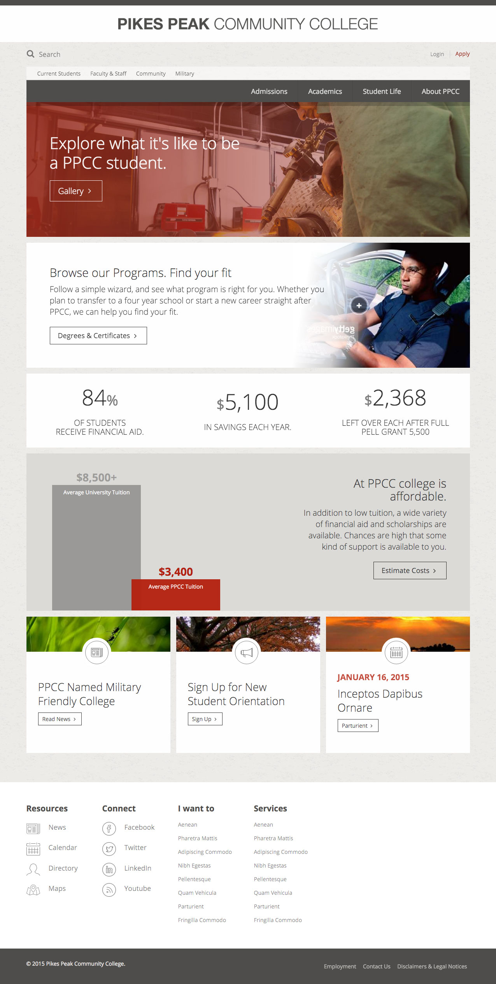
PPCC.EDU
PIKES PEAK COMMUNITY COLLEGE | Spring 2016 PDW
12

Slide 13
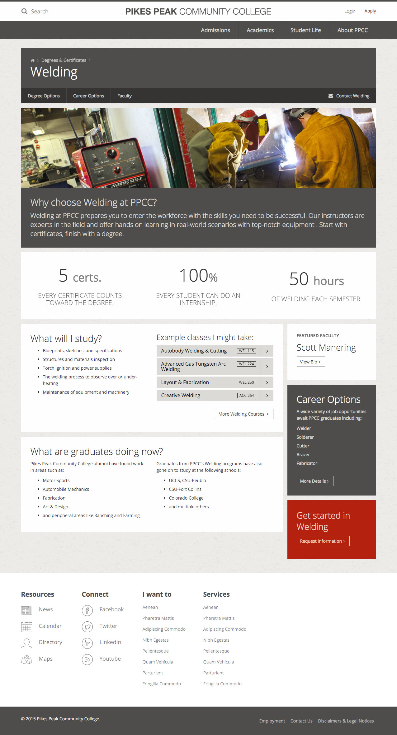
PPCC.EDU
PIKES PEAK COMMUNITY COLLEGE | Spring 2016 PDW
13

Slide 14
PPCC Testing Center
PIKES PEAK COMMUNITY COLLEGE | Spring 2016 PDW
14
Notes:
Our test centers have been awarded the National College Testing Association Test Center Certification. (All three, RRC, DTSC & CC). It is valid for 5 years.

Slide 15
Entrepreneurship Program
Identified possible downtown location
Partnership remains healthy and strong
Outstanding results from summer ‘15 pilot
Working to create a permanent and sustainable model for ongoing operations
PIKES PEAK COMMUNITY COLLEGE | Spring 2016 PDW
15

Slide 16
Pilot Program Updates
True Grit ($50K)
Four AAA109 classes selected (approx. 100 students)
Received weekly motivational texts/emails
Currently evaluating success and editing plan for spring 2016
PIKES PEAK COMMUNITY COLLEGE | Spring 2016 PDW
16

Slide 17
Pilot Program Updates
LED Classroom Lighting Upgrade ($10K)
Two CC classrooms (A167 and A367) retrofitted
Eight additional rooms planned for spring
Two at DTSC
Three at RRC
Three at CC
Completion expected June 2016
PIKES PEAK COMMUNITY COLLEGE | Spring 2016 PDW
17
Notes:
LED Classroom Lighting Upgrade ($10K) – 2 classrooms (A167 and A367) have been retrofitted at CC, with 8 others planned for spring. (2 at DTSC, 3 at RRC, and 3 more at CC). Expected completion by June, 2016.

Slide 18
Pilot Program Updates
Aardvarks Lead the Way in Fighting Debt ($23K)
Purchased software, Loan Tracker, providing Financial Aid new tracking capabilities, such as:
Monitoring all loan borrowers, specifically delinquency borrowers
Communicating with students to get them back in good standing and keep them informed of paperwork, etc.
Since its launch, August 2015, the PPCC Debt/Default Team has assisted more than 50 borrowers resolving delinquency status
PIKES PEAK COMMUNITY COLLEGE | Spring 2016 PDW
18
Notes:
Aardvarks Lead the Way in Fighting Debt ($23K) – The Financial Aid office purchased software, Loan Tracker, that allows us to track our prior loan borrowers in all stages of their loans, specifically delinquency stages ; early 31-99 , mid 100-190, and late stage 190-269 days delinquent on student loan payments. This software gives us an actually breakdown of who these students are (something we did not have before), allowing us to reach out to these specific students via email/phone to assist them in getting back in good standing with their student loans. This software also allows us to track these students once we have reached out to them, which makes for easier follow-ups with regard to paperwork we have completed and are awaiting back from their loan servicers, again something we never have had the access to do. Since we have had this software, August 2015, our Debt/Default Team has been able to effectively assist over 50 borrowers resolve their delinquency status on their student loans, again something we have not been as successful in doing up until now. We are continuing to learn and take advantage of all the tools that this software has to offer us with assisting us in reducing our default rates.

Slide 19
Pilot Program Updates
Writing Fellows ($12K)
Four Writing Fellows hired in fall 2015
Provided peer reviews and individual draft-improvement consultations for four sections of HIS101
Assessment underway
Project repeats spring and fall 2016
PIKES PEAK COMMUNITY COLLEGE | Spring 2016 PDW
19
Notes:
Writing Fellows ($12K) – This past Fall Semester, four (4) Writing Fellows were hired that supported students by providing peer reviews of essay drafts and individual draft-improvement consultations in four (4) sections of HIS101, a targeted writing intensive course. Results and assessment of the Fall activity are underway. This project will be repeated Spring and Fall semesters of 2016.

Slide 20
Pilot Program Updates
Rampart Range Recycling Stations ($13K)
Determined unit specs
Out to bid spring semester 2016
Project completion estimated June 2016
PIKES PEAK COMMUNITY COLLEGE | Spring 2016 PDW
20
Notes:
Rampart Range Recycling Stations ($13K) – have determined unit specs and will be putting out to bid this Spring semester. Anticipate completion of project by June, 2016.

Slide 21
Campus Safety
Measures to improve campus safety
Trainings:
Surviving the active shooter
Refuse to be a victim
Defusing hostile people
Robbery prevention
Mental preparedness for physical defense
Campus emergency response training
Campus safety briefings
PIKES PEAK COMMUNITY COLLEGE | Spring 2016 PDW
21

Slide 22
Campus Safety
Measures to improve campus safety
Video Cameras
Escorts to/from vehicles
Campus broadcast systems
Door locks
Room numbers posted inside
Drills and Table-Top exercises to prepare our campuses
Safe-to-Tell Program
Professional post-certified, armed police force on campus
PIKES PEAK COMMUNITY COLLEGE | Spring 2016 PDW
22

Slide 23
Student Success Software
PPCC will participate as a pilot school implementing Student Success Software in 2016.
Jennifer Sengenberger and I are participating in the RFP process.
Exciting Technologies emerging to help students navigate through college: Degree Objectives, Scheduling, Staying on Track for Graduation, Push Messaging and Notifications.
PIKES PEAK COMMUNITY COLLEGE | Spring 2016 PDW
23

Slide 24
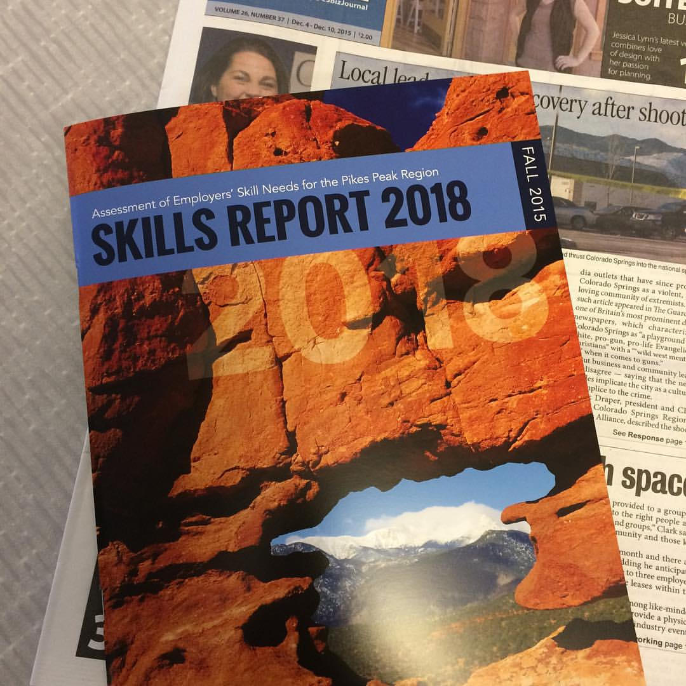
Skills Report
Health Care
Manufacturing
Computer Systems, IT, Cyber Security
PIKES PEAK COMMUNITY COLLEGE | Spring 2016 PDW
24

Slide 25
Construction Updates
PPCC.EDU/CONSTRUCTION
Look for the cone to receive all the latest updates about PPCC Construction Projects.
PIKES PEAK COMMUNITY COLLEGE | Spring 2016 PDW
25

Slide 26
Construction Updates: Completed
Completed
Lactation Rooms: One lactation room added at CC, DTSC and RRC
CC Bake Shop Floor: Old floor replaced with commercial kitchen flooring
CETL Collaborative Room A228
A229 Suite
CC ADA Parking
PIKES PEAK COMMUNITY COLLEGE | Spring 2016 PDW
26

Slide 27
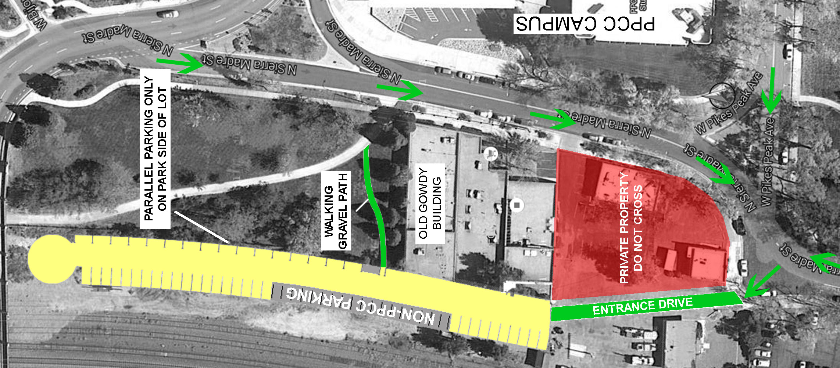
Construction Updates: Completed
DTSC 22 N. Sierra Madre Parking
65 spots, includes 10 for lawyers and eight for Fatbike
PIKES PEAK COMMUNITY COLLEGE | Spring 2016 PDW
27

Slide 28
Construction Updates: Completed
Classroom Improvements
Completed
CC | DTSC
A168, A169, A217, A219, A253, A255, A256, A258, A259, | S120, N203, N206
PIKES PEAK COMMUNITY COLLEGE | Spring 2016 PDW
28

Slide 29
Construction Updates: In Progress
In Progress
CC Hillside: Demolition and re-grading underway
CC Phase II Boiler Replacement: installed summer 2016
RRC Walking Path: Early schematic stage, working with Student Government
PIKES PEAK COMMUNITY COLLEGE | Spring 2016 PDW
29

Slide 30
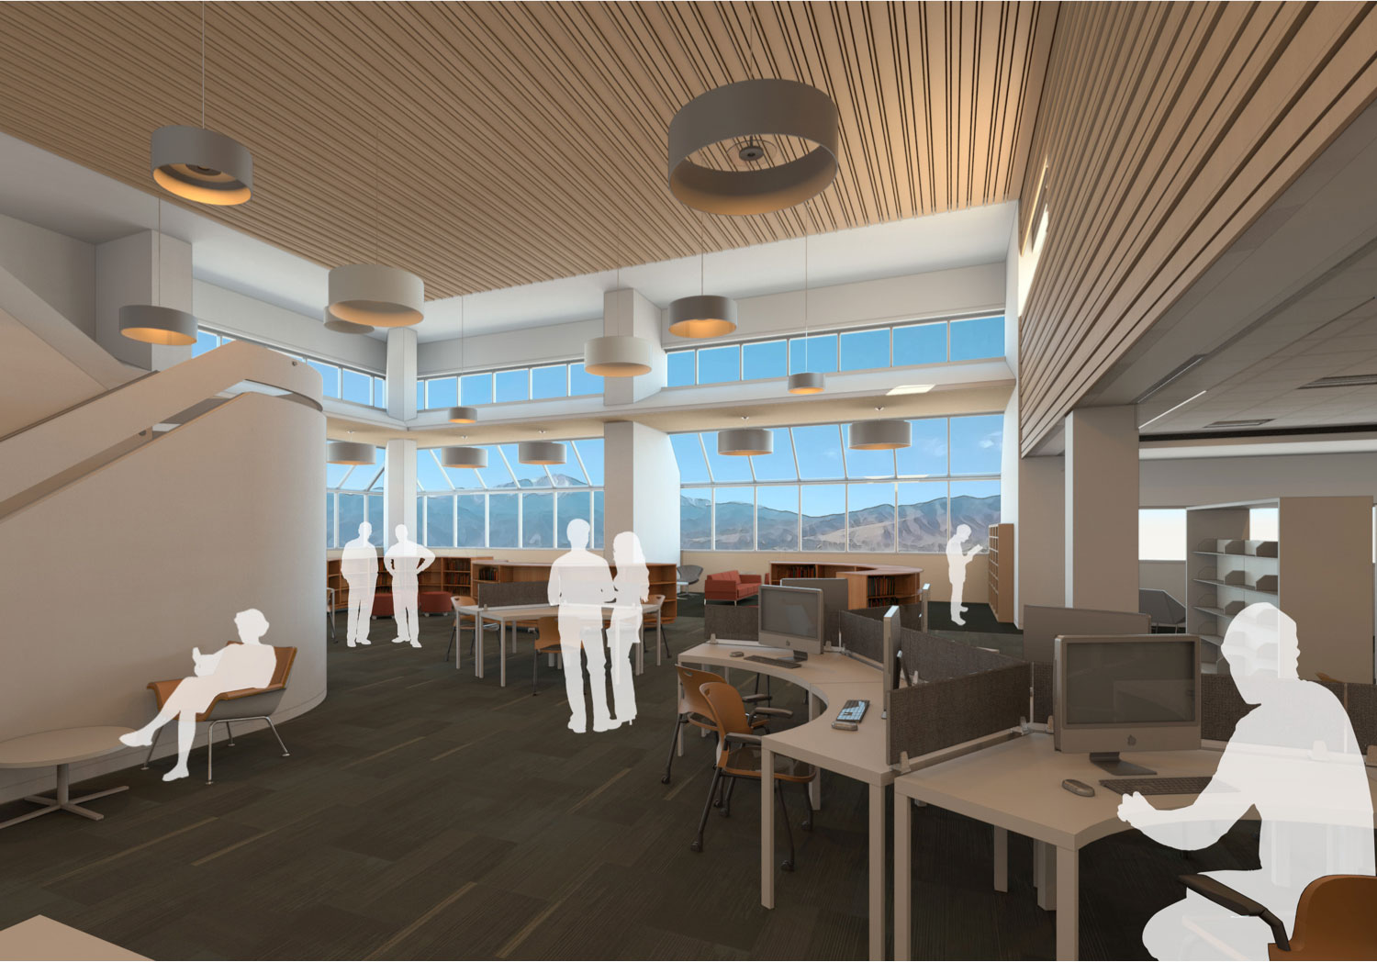
Construction Updates: In Progress
Learning Commons
PIKES PEAK COMMUNITY COLLEGE | Spring 2016 PDW
30
Notes:
There are a total of 10 photos/rendering for the commons and enrollment services. We couldn’t fit them all, so be sure to tell people to check out ppcc.edu/construction to see everything.

Slide 31
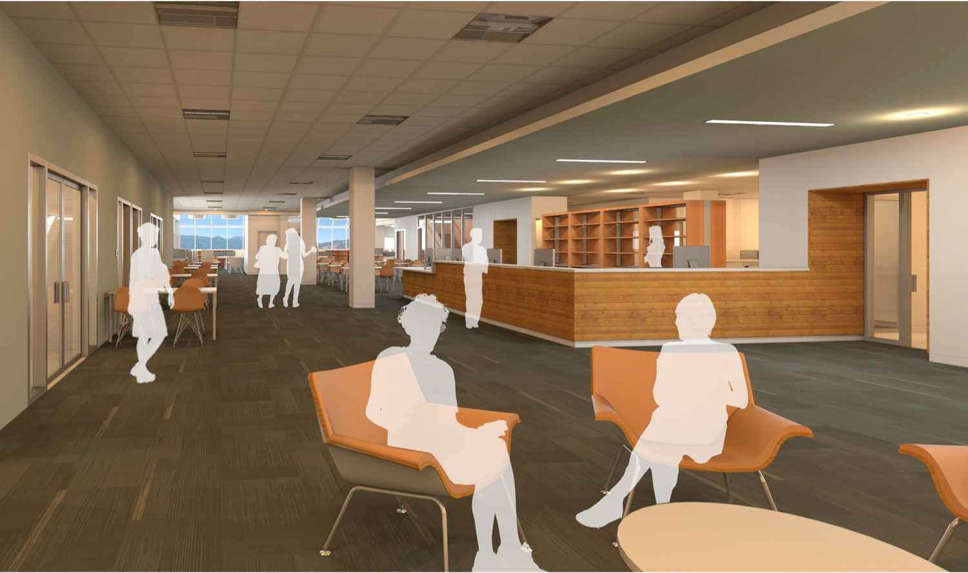
Construction Updates: In Progress
Learning Commons
PIKES PEAK COMMUNITY COLLEGE | Spring 2016 PDW
31

Slide 32
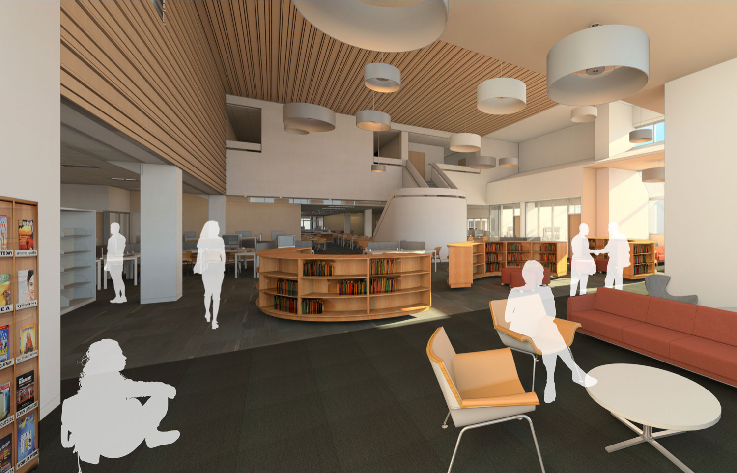
Construction Updates: In Progress
Learning Commons
PIKES PEAK COMMUNITY COLLEGE | Spring 2016 PDW
32

Slide 33
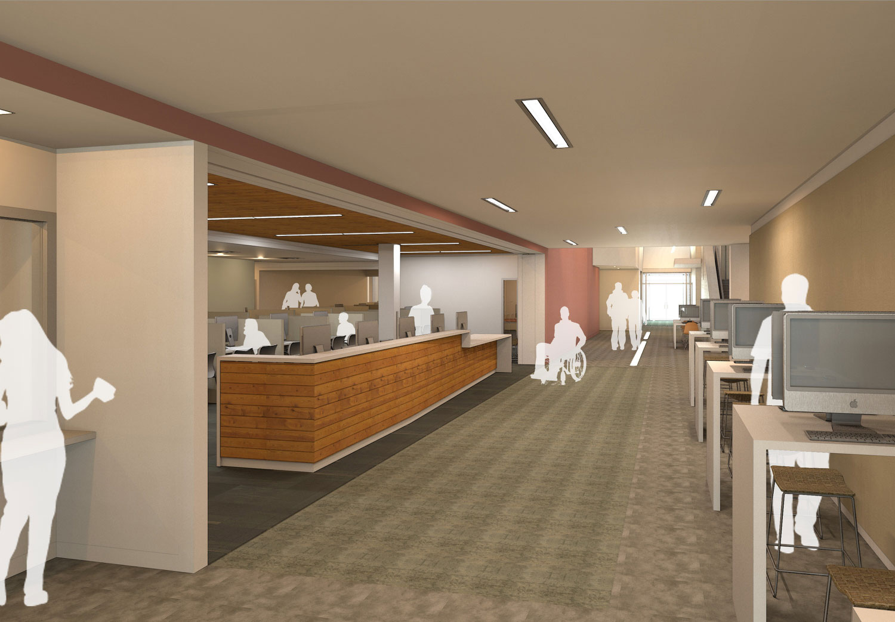
Construction Updates: In Progress
Enrollment Services
PIKES PEAK COMMUNITY COLLEGE | Spring 2016 PDW
33

Slide 34
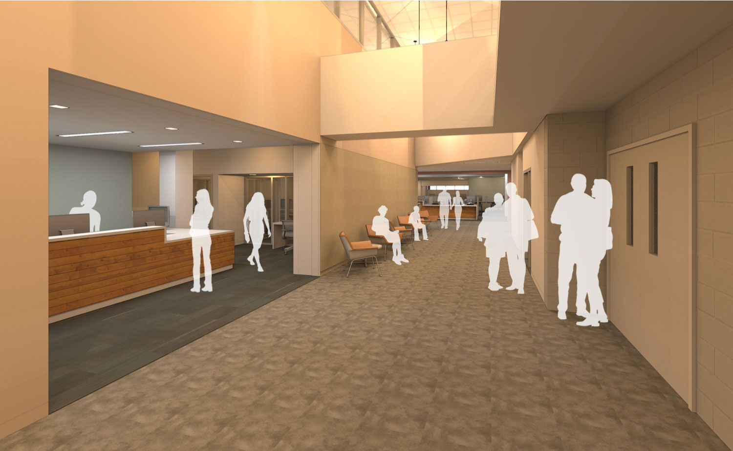
Construction Updates: In Progress
Enrollment Services
PIKES PEAK COMMUNITY COLLEGE | Spring 2016 PDW
34

Slide 35
Construction Updates: In Progress
Classroom Improvements
Through June 2016
CC | DTSC | RRC
A168, A169, A217, A219, A253, A255, A256, A258, A259, A311, B301, B309 | S103, S120, N203, N206 | W112, W116, W117, W118
PIKES PEAK COMMUNITY COLLEGE | Spring 2016 PDW
35

Slide 36
PIKES PEAK COMMUNITY COLLEGE | Spring 2016 PDW
36

