Slide 1
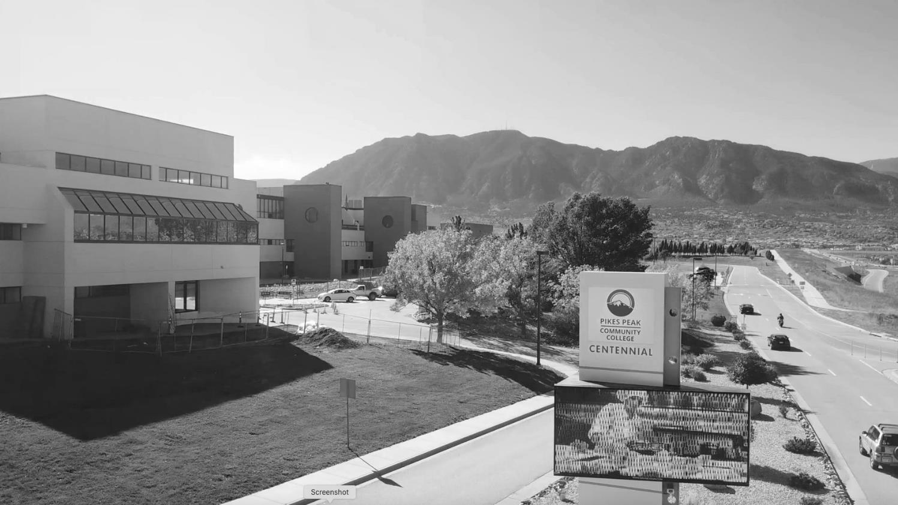

PRESIDENT’S
ADDRESS
2021 SPRING PDW
LIGHT AT THE END OF THE TUNNEL

Slide 2


UPHEAVAL

Slide 3

REASONS FOR HOPE
EL PASO COUNTY HEALTH DASHBOARD
https://www.elpasocountyhealth.org/covid19data-dashboard
Notes:
What this means for spring and beyond
- Hopeful themes about opening back up for regular classes sometime during Spring ‘21 semester. Including a grand opening of our really lovely Studio West.
- Vaccine rollout. 1B. What that means and how we'll be notified.
- Graduation might be in-person
- Challenges our students and employees are facing during the pandemic and our efforts to support people.

Slide 4


COVID

Slide 5

PLANS FOR
SPRING
Plans for spring semester
Vaccine rollout
Graduation
Testing station at Rampart
Hours extended: 8 a.m.-6 p.m.
Challenges students and employees continue to face
Notes:
That last included one of the best faculty art shows ever and the current discipline presentation, "Still Moving," which is still available to view. And the Foundation's Scholarship Event may be the best virtual event we've ever produced. The video thank you's from students were especially moving.

Slide 6

COVID CASES
AT PPCC
234
8/24/20–12/23/20

Slide 7
COVID CASES AT PPCC
Total COVID-19 Cases | On-Campus | 138
Confirmed positive cases | 132
Students | 98
Staff | 17
Faculty | 4
Student Employees | 12
Contract Employees | 1
Probable | 6
Students | 5
Faculty | 1

Slide 8
COVID CASES AT PPCC
Total COVID-19 Cases | Off-Campus Online, remote, not on campus while infectious, etc. | 96
Confirmed positive cases | 93
Students | 74
Staff | 9
Faculty | 7
Student Employees | 3
Contract Employees | 1
Probable | 3
Students | 3

Slide 9
COVID CASES AT PPCC
Total Outbreaks | 4
Centennial Campus Nursing Students (NUA-N10) | 3
Campus Police Staff | 3
Rampart Range Campus Biology Students (BIO 201-175) | 2
Centennial Campus Computer Lab Student Employees | 4

Slide 10
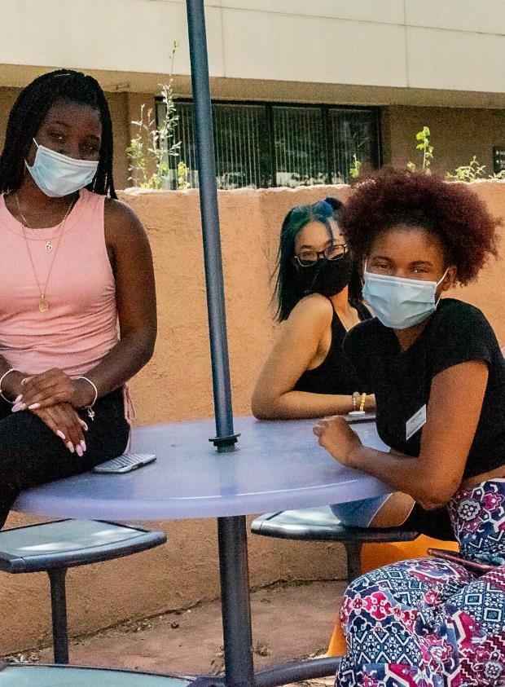
HOW WE ALL ADAPTED
Fall Surveys
Faculty Survey
Preferred Live Remote Platform | 46%
Do you favor a consistent platform? | 50/50 split
Preferred platform?
Zoom = 58% | WebEx = 38% | MS Teams = 4%
Student Survey
Preferred Instructional Methods
“In-person” remains the most preferred instructional method
Live Remote
Most students know where to get help (63%), have reliable internet connection (70%) and adequate technology (76%)
Main Challenges
Limited opportunities for hands-on experiences and group activities
Staying motivated to do well in a remote learning environment
Not being able to ask questions or get immediate feedback from my instructors when attending recorded class sessions
Fitting the course in with my home/family/work responsibilities

Slide 11
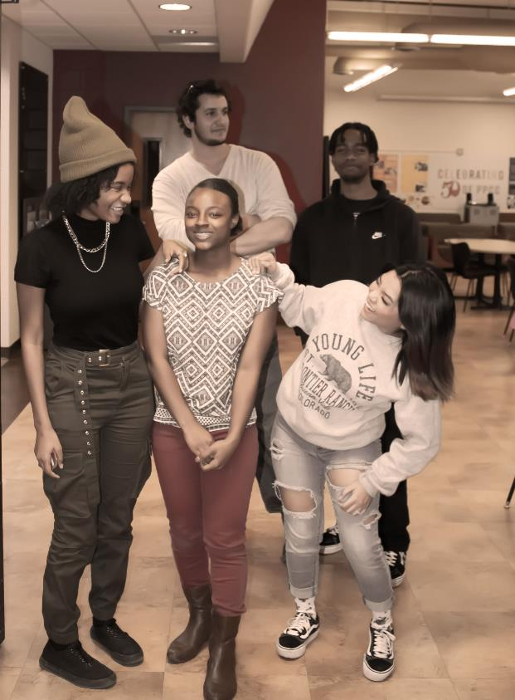
HOW WE ALL ADAPTED
STUDENT RESILIENCE
Pass, Fail, W, and I rates for fall 2020 and fall 2021.
Fall 2020
Pass | 75.1%
Fail | 17.8%
W | 6.9%
I | 0.3%
Fall 2021
Pass | 74.4%
Fail | 17.6%
W | 7.5%
I | 0.5%

Slide 12
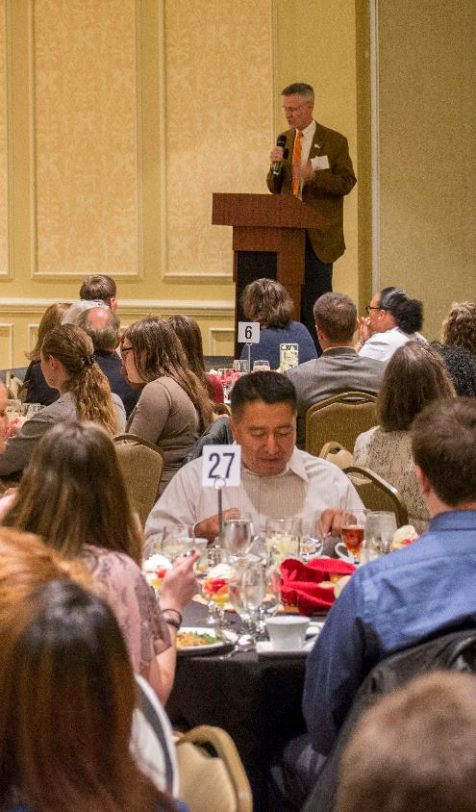


FOUNDATION
The Foundation had planned for one round of scholarship applications in 2020. They ended up offering three. Since the pandemic, students have received:
$1.3 Million
In Scholarships
50
Computers

Slide 13



Applications for fall semester will be accepted from April into June
FOUNDATION
The Foundation has also used this moment to re-assess how application timelines are aligned with student decision making.
What's going to change »
Students who have scholarships in spring may receive awards for fall without submitting another application
Applications for Spring semester will be accepted in October.

Slide 14
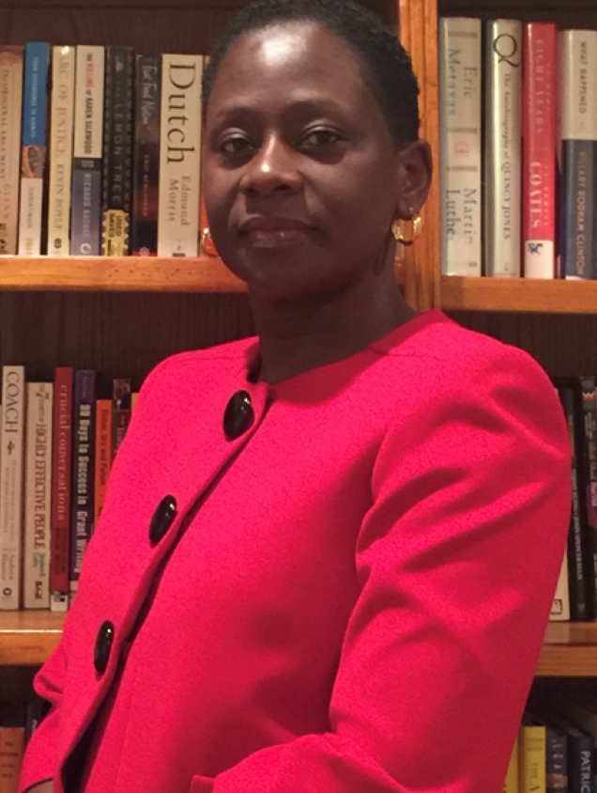
NEW STUDENT OMBUDS
SARAH KITONSA
Notes:
In addition to her role as Student Ombuds, she also serves as the Scholarship Coordinator with the PPCC Foundation. She's a great fit for the ombuds role. Before joining PPCC, she worked as a human rights attorney with the Human Rights Commission in Uganda. She holds an Executive MBA from the University of Denver and a Master of Laws in Public Interest Law from New York University School of Law. She also trained as an Alternative Dispute Resolution legal professional with the International Development Law Institute in Rome.
As a student Ombuds she represents the College as a neutral party in resolving complaints involving students, parents and other guests of the college.)

Slide 15

VIRTUAL
SUCCESSES
Commencement
Drive-In Family Movie Night
Service Awards
Scholarship Event
Jingle Mingle
CEID Trainings
Cultivate Professional Development
Arts presentation
Notes:
That last included one of the best faculty art shows ever and the current discipline presentation, "Still Moving," which is still available to view. And the Foundation's Scholarship Event may be the best virtual event we've ever produced. The video thank you's from students were especially moving.

Slide 16

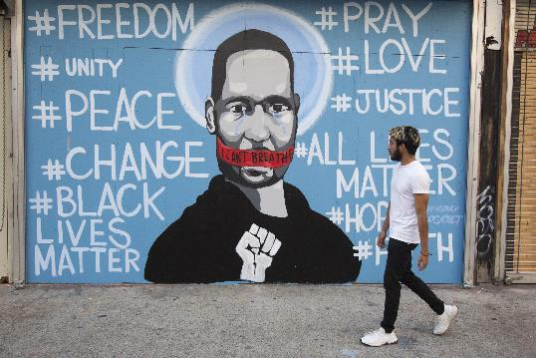
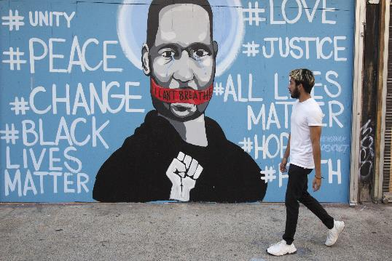
CHANGES IN CULTURE

Slide 17
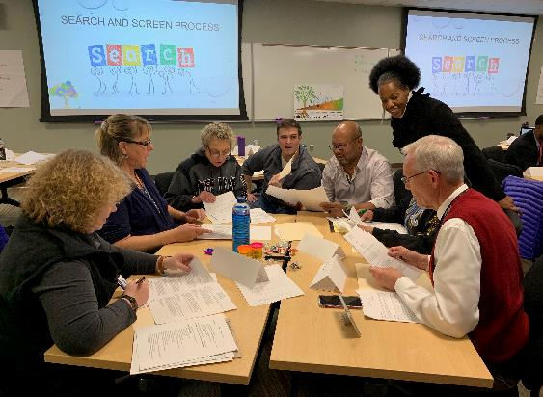
ANTI-RACISM: DIVERSITY, EQUITY AND INCLUSION
CLASSROOM EQUITY:
INSTRUCTIONAL SERVICES EQUITY PLAN
Equity and Diversity Work Needs To Be Infused into Everything We Do
Address equity gaps
Love and care for students drive change and improvement
We can all improve everyday
Employee training and hiring practices
Courageous conversations
Support from the system office

Slide 18
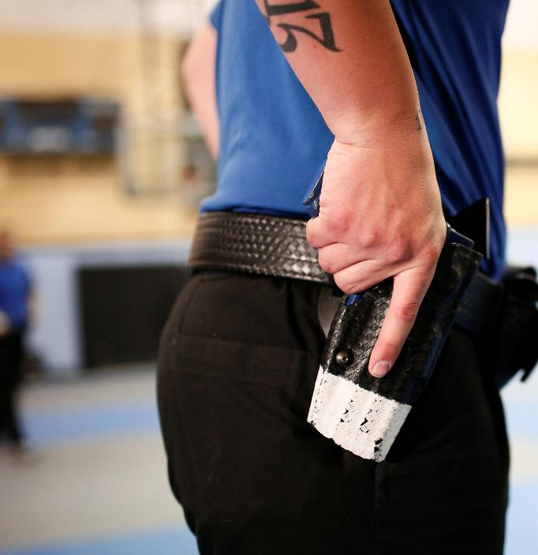
POLICE
REFORM
PPCC's Empathy Project could be a pilot project that goes statewide.
$1 million grant from the Colorado Health Foundation to CCCS
Uses Virtual Reality to foster empathy
First VR modules expected in February
Notes:
That last included one of the best faculty art shows ever and the current discipline presentation, "Still Moving," which is still available to view. And the Foundation's Scholarship Event may be the best virtual event we've ever produced. The video thank you's from students were especially moving.

Slide 19
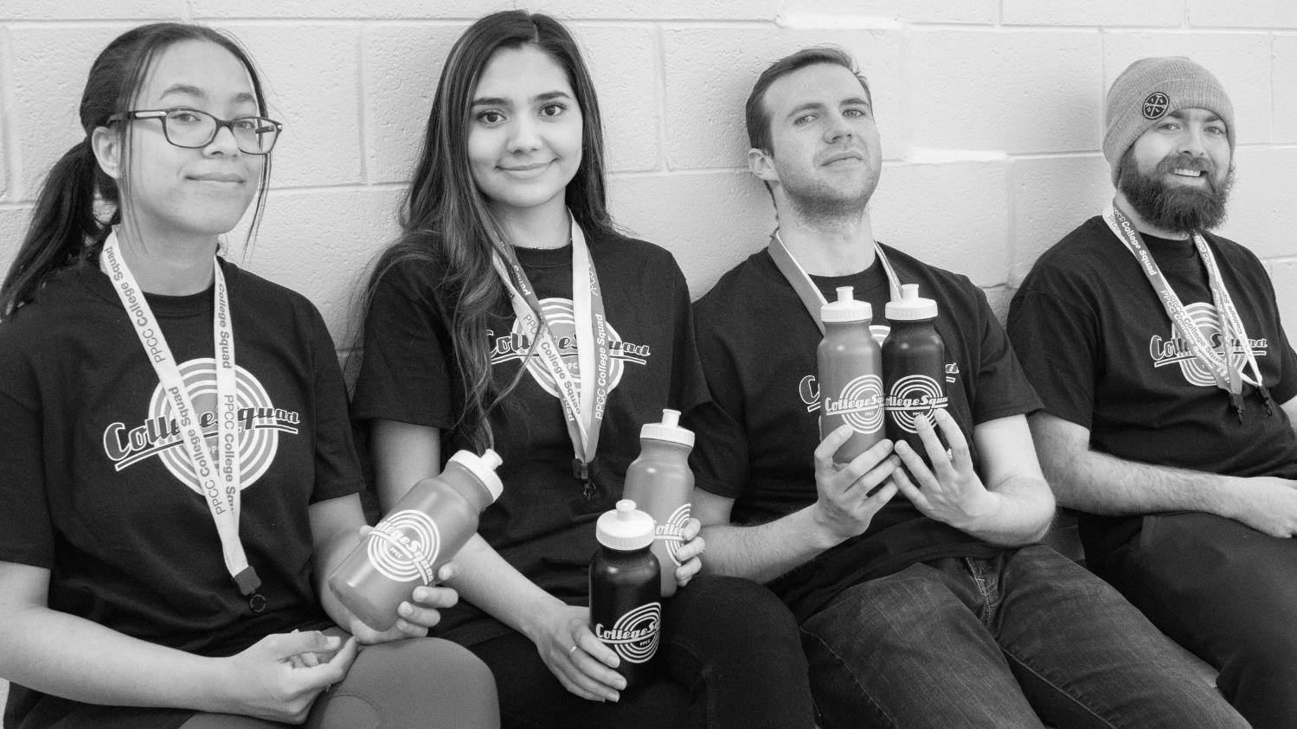
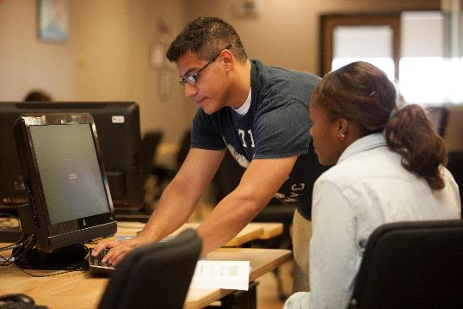
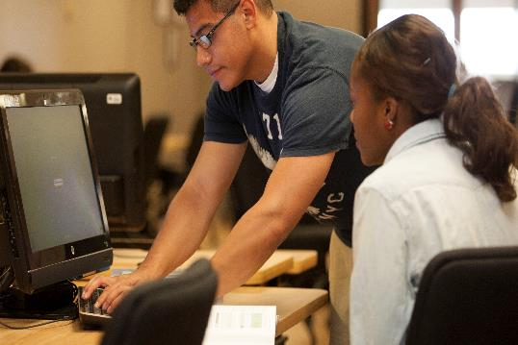
STATUS REPORT

Slide 20
ENROLLMENT
SEMESTER FTE | SUMMER | FALL | SPRING | AY
AY 19/20 | 2,187 | 8,369 | 7,776 | 18,332
AY 20/21 | 2,108 | 7,560 | 6,637 As of 1/10/21 | 16,305 As of 1/10/21
% Change | -3.6% | -9.7% | -14.7% As of 1/10/21 | -11% As of 1/10/21

Slide 21
RETENTION
55%

Slide 22

RETENTION BY RACE/ETHNICITY
RACE/ETHNICITY | PERCENTAGE
White | 56%
Hispanic | 51%
Black | 45%
HISPANIC ENROLLMENT
Increased from 16% to 21% between Fall 2016 and Fall 2020

Slide 23
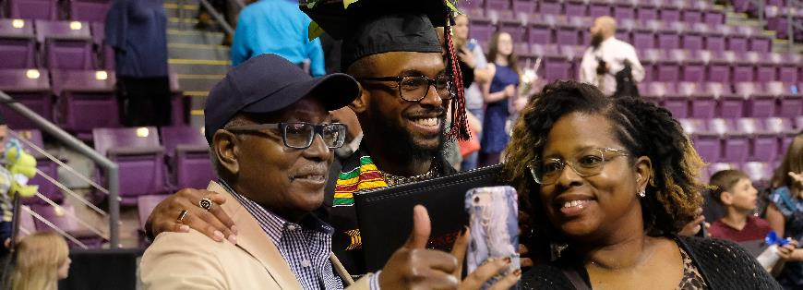
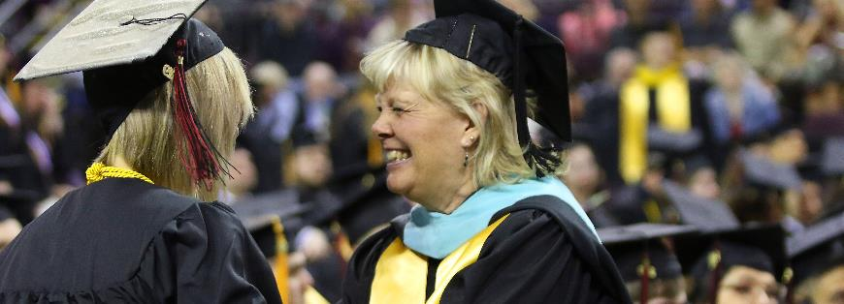
GRADUATION
Degrees and Certificates
3,970 | 17/18
4,060 | 18/19
3,879 | 19/20

Slide 24

3-YEAR GRADUATION RATES (FALL 2017 COHORT)
White | 29%
Hispanic | 17%
Black | 7%

Slide 25


COLLEGE RESERVES
FY18
FY19
FY20
$39,942,875
48.5%
$33,889,597
39.2%
$31,119,838.60
33.9%

Slide 26

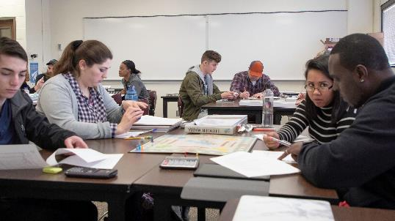
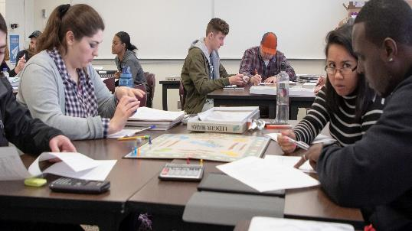
WHAT’S NEXT

Slide 27

CCCOnline

Slide 28

LEGISLATIVE
SESSION

Slide 29
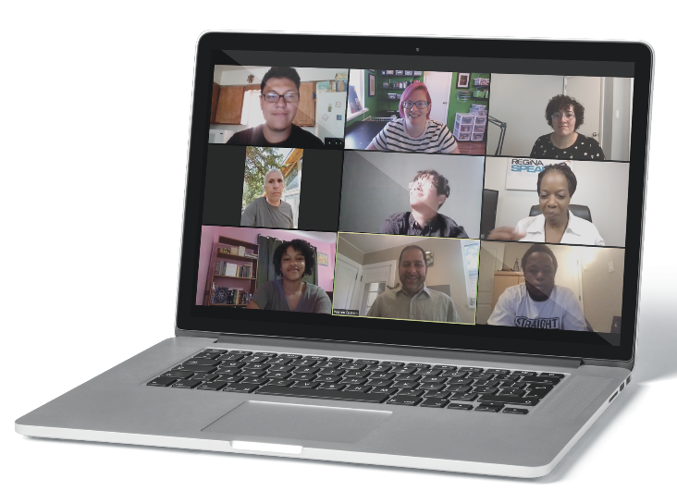
THE REMOTE INSTRUCTION LAUNCHPAD
In the "Discover" tab in D2L.
Remote Instruction Launchpad Units:
Zoom and WebEx: The Gateway to Your Classroom
D2L Best Practices: Making Your Life Easy
Attendance Options: Taking the Headache out of Taking Attendance
Lecture Tips: Practical Ideas for the Remote Classroom
Activity Tips: Keeping Students Engaged

Slide 30

PPCC CULTIVATES
A staff-development program
In addition to the on-going Enhancing Leadership Program and Supervisor Development Program, Cultivate has added:
Digital Badging
PPCC Employees can now earn verifiable, web-based digital credentials for their professional-development.
Upcoming Special Event
Arnie Einstein Quiz Bowl, which is a bracket-style trivia competition created in partnership with Student Life. Teams of four employees will compete for fame, glory, and cool prizes for a team to join, we have some openings.

Slide 31
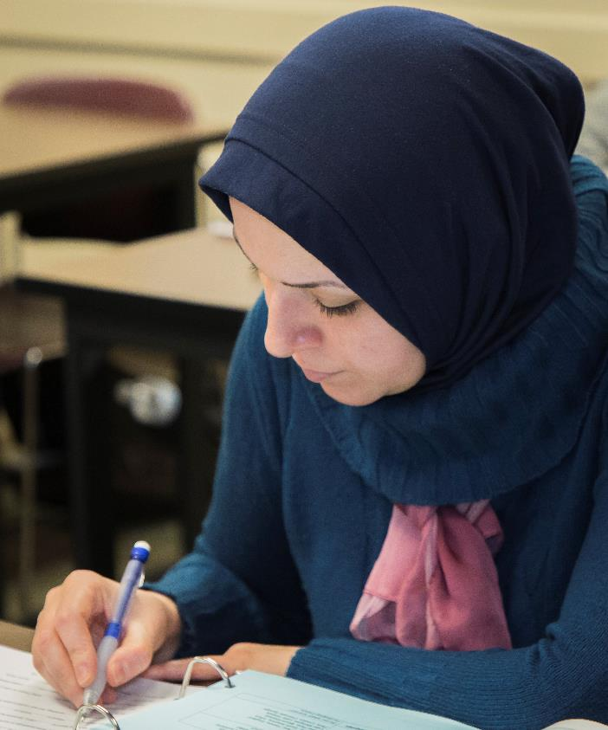
NEW CARES ACT
FUNDING
CRRSAA | Coronavirus Response and Relief Supplemental Appropriations Act Effective 1-5-21

Slide 32
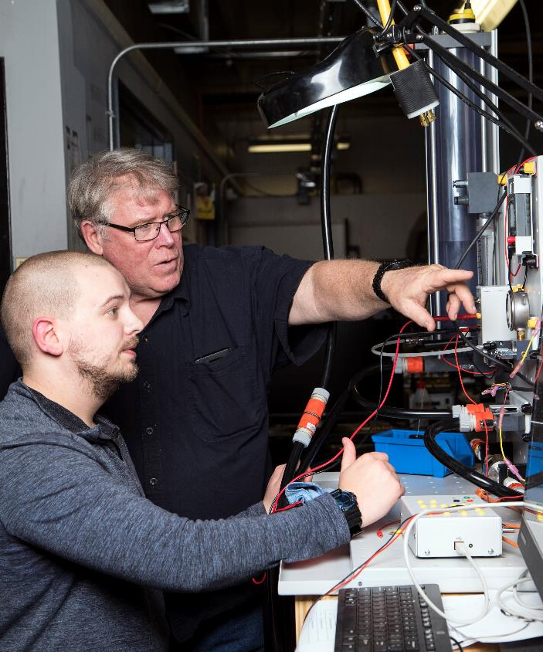
First Year Experience for Students
Coaching
AAA
Co-Req
Math Pathways
School District Work
College readiness
Saving a lost generation (COVID)

Slide 33



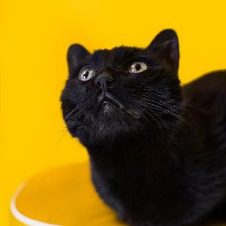
NEW
ACADEMIC
PROGRAMS
In Development
Vet Tech
Physical Therapy Assistant
Facilities and Industrial Maintenance
Launched Fall 2020
AGS Secure Coding
AGS Hospitality
AGS Emergency Management & Planning
Certified Addiction
Counseling Courses
Vet Assistant

Slide 34
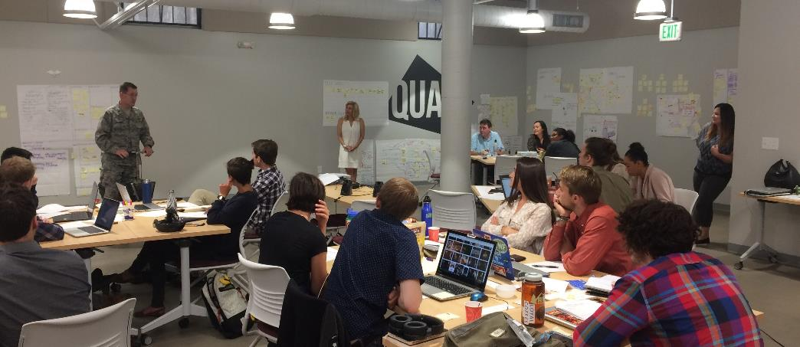
Remains an essential partnership with our higher-ed peers.
More than an internship. Puts students and recent graduates to work solving real-life community problems.

Slide 35
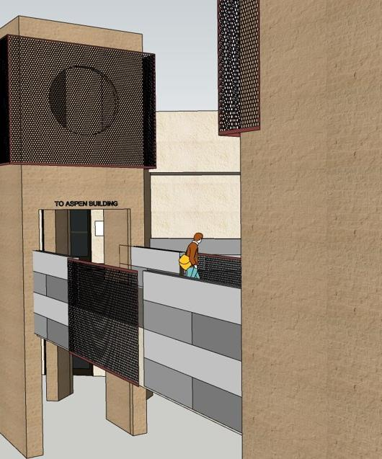
FACILITIES
UPDATES
In Construction
Emergency Generator
Walkways Renovation
DTS Fire Sprinkler
Gym Remodel
Upcoming Projects
DTS Learning Commons
Roofing Project
Completion Winter 2021
Restroom Upgrades
Phase I (Aspen) CC Completion October 2021
Phase II (Breckenridge) CC
Completion October 2021
TBA
FREE Complex
CTE Building

Slide 36
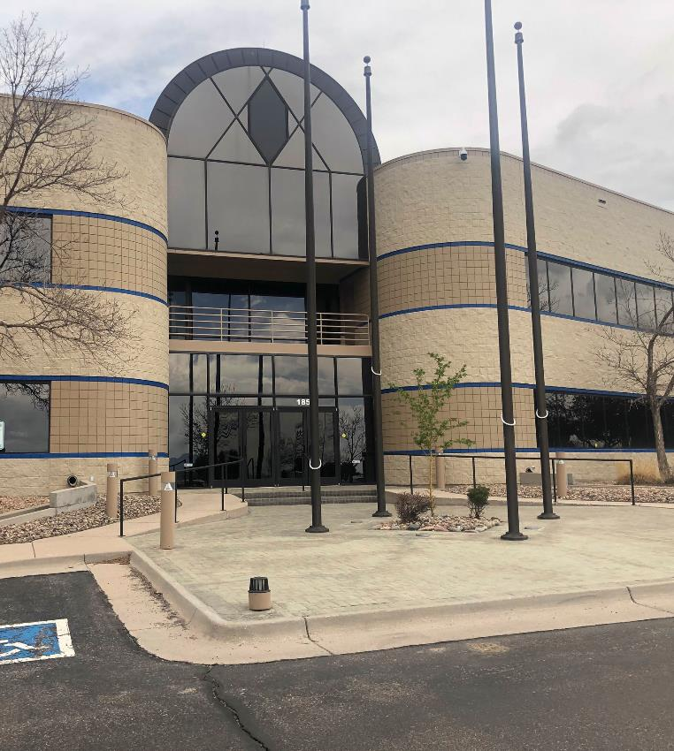
CENTER FOR HEALTHCARE EDUCATION & SIMULATION
CHES Phase 2

Slide 37
THANK YOU.
QUESTIONS?

