Slide 1



Fall 2026 PDW
Requesting Events in AdAstra​
EventsManagement@pikespeak.edu

Slide 2
What We Will Go Over
How to Submit the Event Request Form
  Finding Rooms
  Requesting Support from IT and Facilities
  Large Events/Conferences
What Happens After the Event Request is Submitted
How to Edit or Cancel a Scheduled Event
Terms to Know:
  Resources = anything IT or Facilities need to bring to the space, including support
  AdAstra = Scheduling Software
  Location = any room/space the event will use

Slide 3
What to Know Before Submitting the Request
Have an idea on campus, and number of rooms needed.
Have an idea of what the event will need from IT and Facilities
  Include as much information as possible on request
  Easier to update later instead of adding things
  Can make estimations at the start to reserve
For your event to go smoothly, please have your event verified at least two weeks before the day of the event.
  Resources may not be approved if added within one week of the event happening

Slide 4
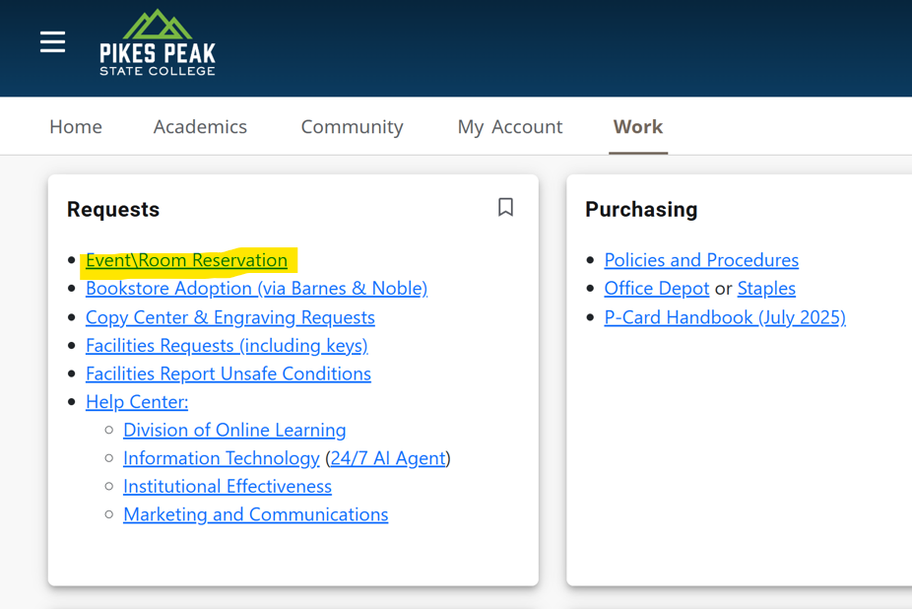
Where to find the Event Request Form?

Slide 5
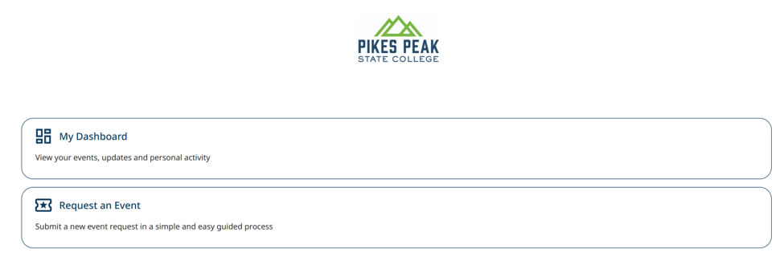
Event Request Form Landing Page
My Dashboard
  See Submitted Event Request Status
  Sorted by Soonest Event
  Can See Date, Time, and Location
Request an Event
  Submit New Event Request

Slide 6
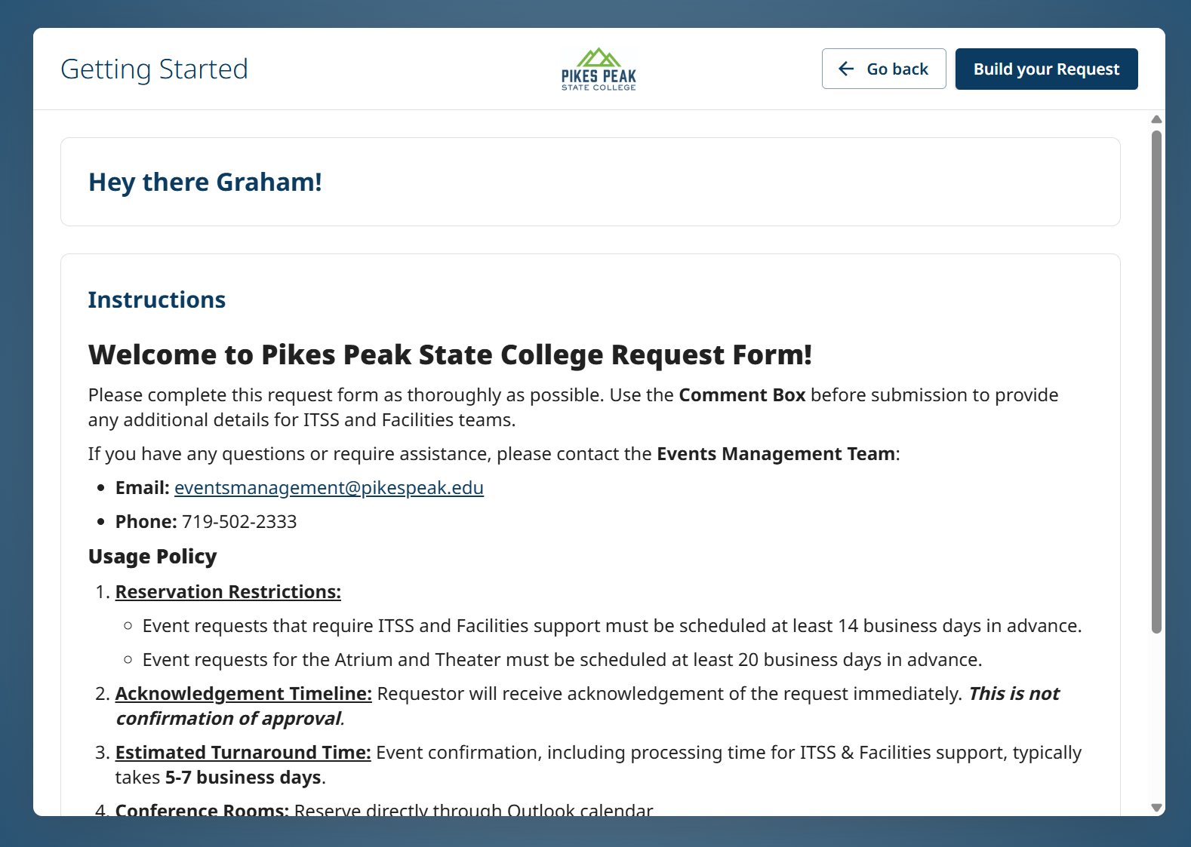
Request an Event- Landing Page
General information about timelines, and contact information for questions
Click the “Build your Request” button to move forward with event request
Notes:
Make this screen shot bigger

Slide 7
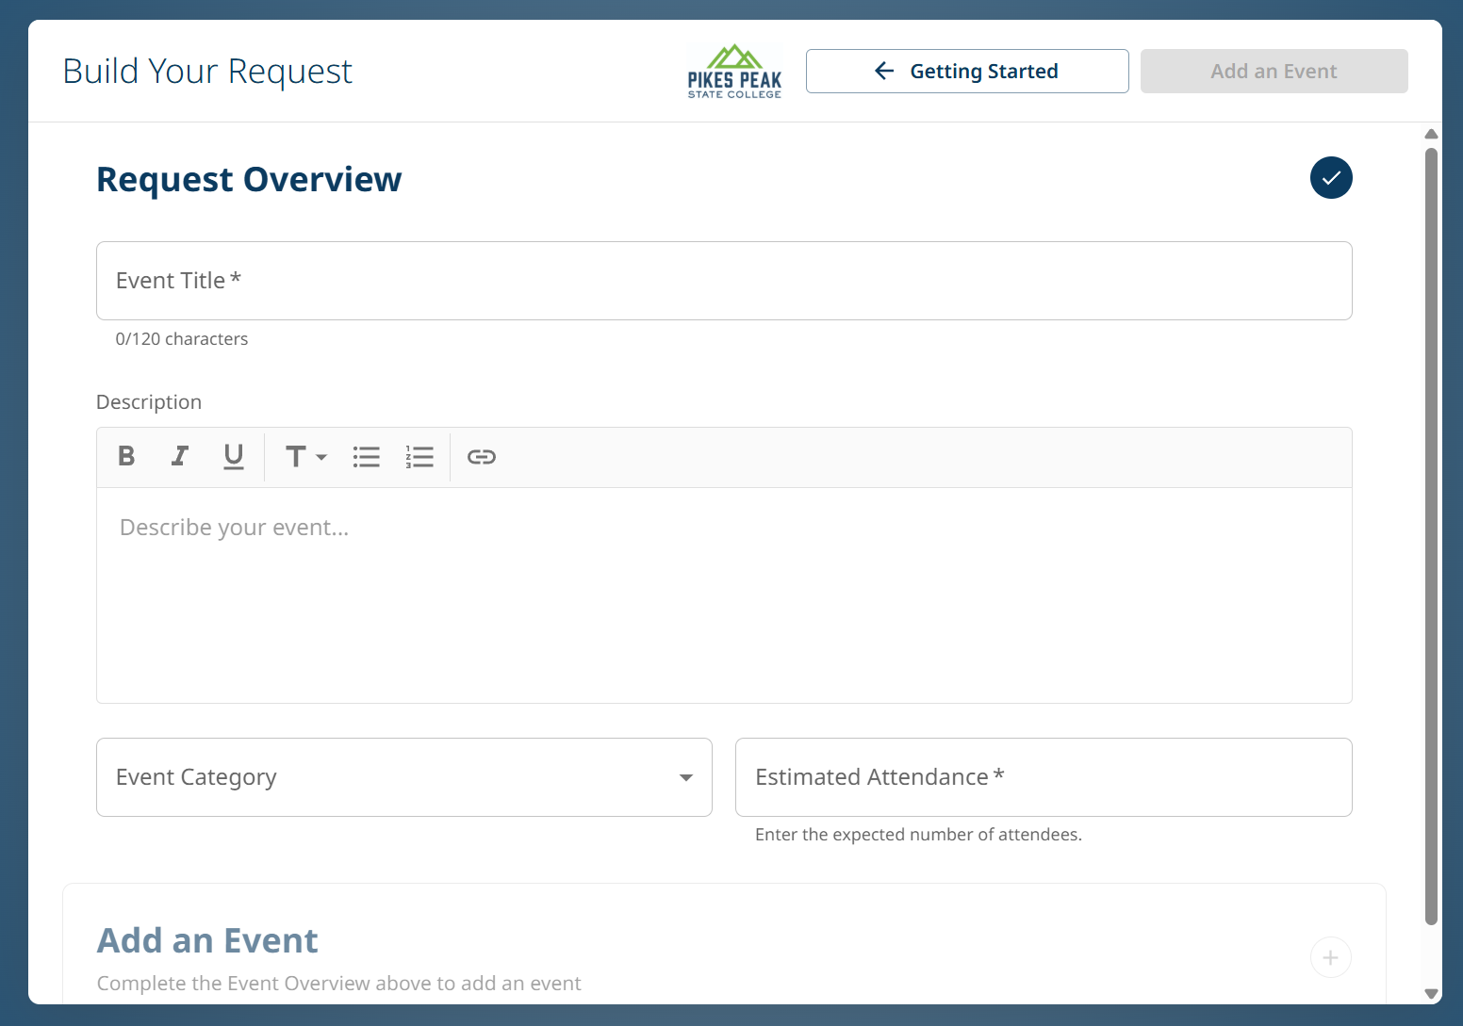
Building your Event Request
Event Title: will be the name in AdAstra
Description:
  More information on event
  Include resources not on request
Event Category: chooses type of event
Attendance: 100 or more will notify Campus Police. 200 or more will require additional officers on duty
After answering all questions, click “Add an Event” at the top or bottom

Slide 8
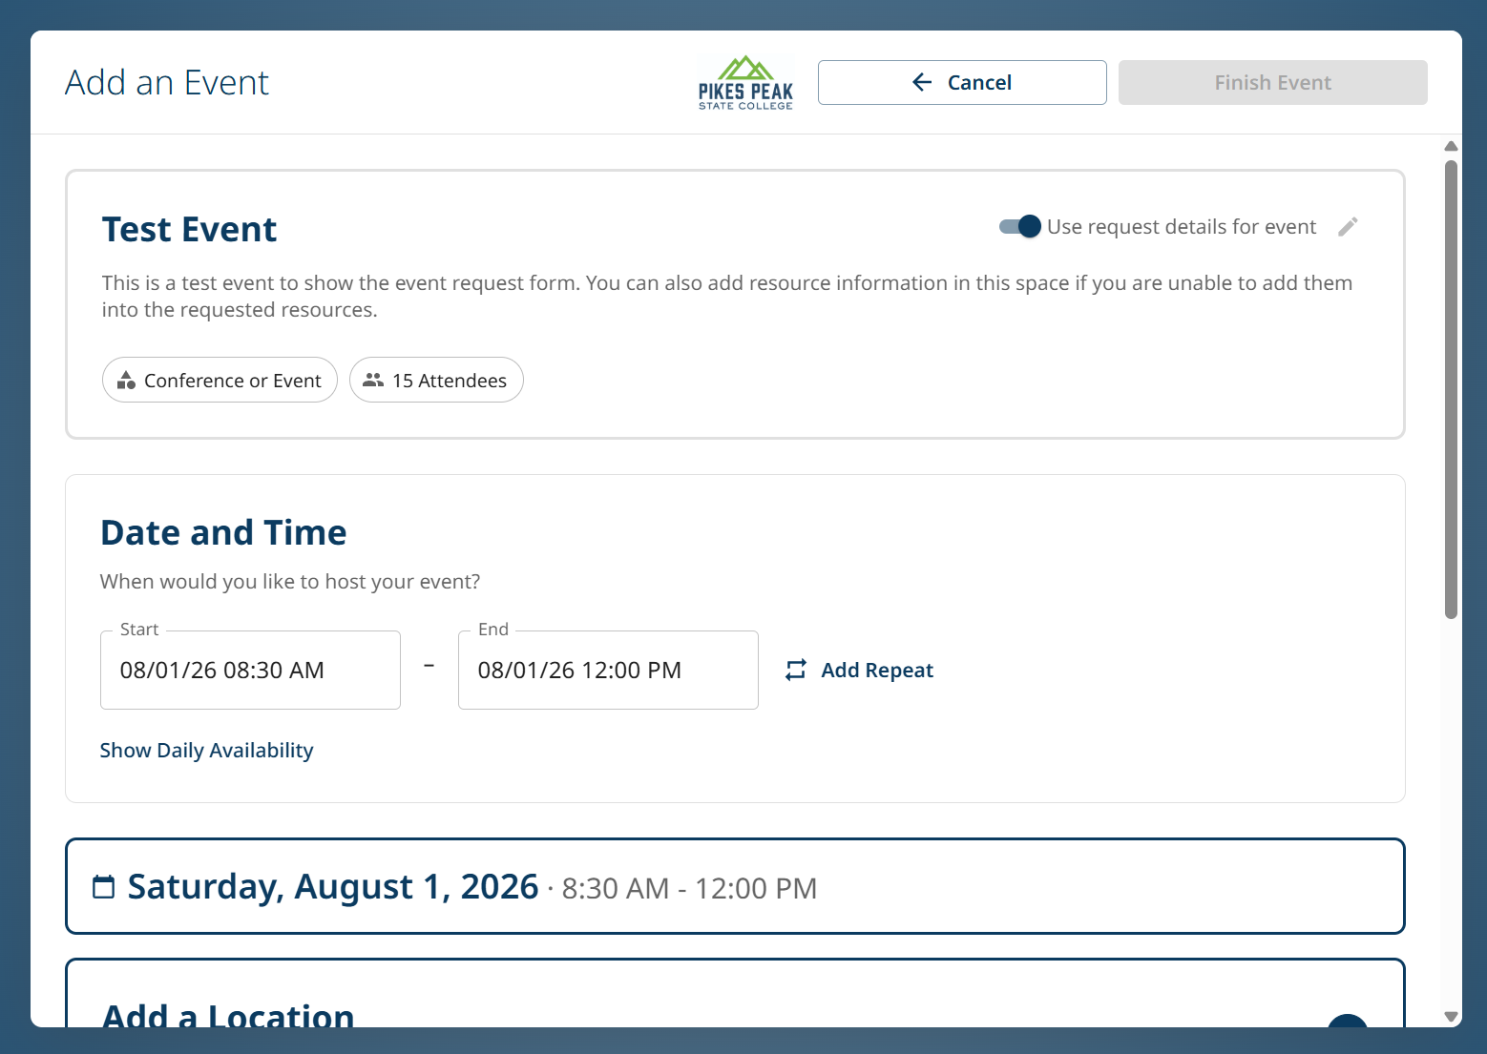
Adding an Event-
Date and Time
Date and Time:
  Request specific days/times up to 180 days in advance
  Include extra time for setup and tear-down
  8:00 am is earliest requestable time, include early setup time in description
  Add Repeat if reserving room same day/time each week
  Can add additional days later

Slide 9
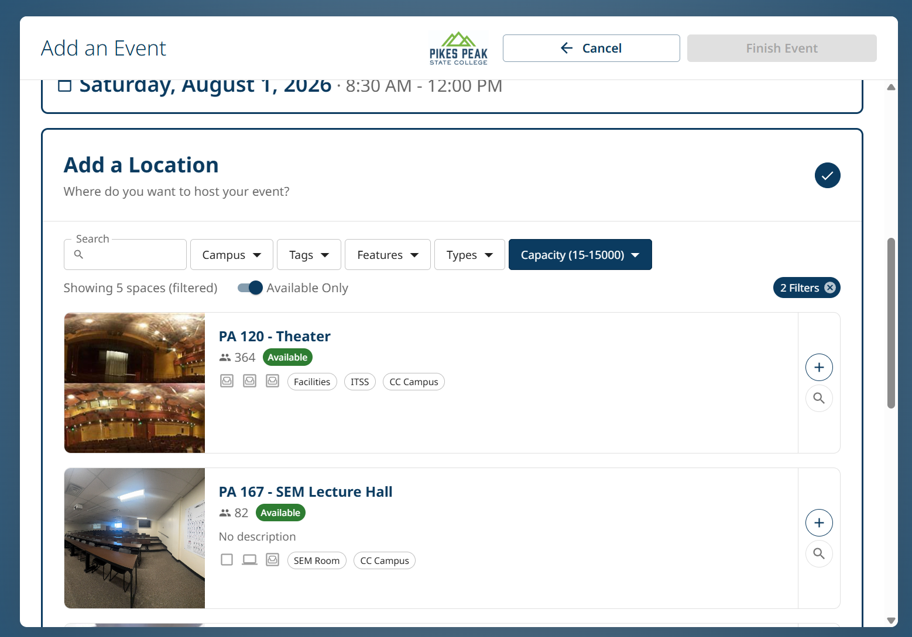
Adding an Event-
Choosing Rooms
Can filter rooms by Campus
  PCE is Centennial
  PDO is Downtown
  PHC is CHES
  PRR is Rampart
Available Only switch will show you rooms that are unavailable and give reason
Search- type fast!
  PA = Centennial Campus
  PHEC = CHES Campus
Notes:
Try to push then towards finding their own rooms

Slide 10
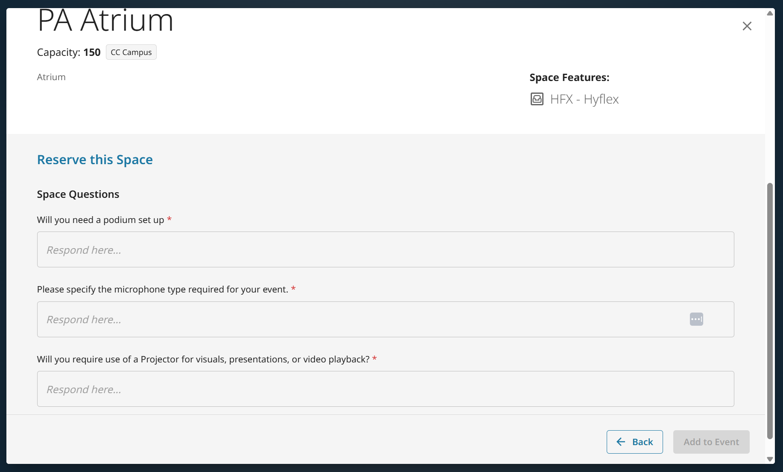
Room Questions
Some rooms have specific questions for more information to ITSS/Facilities (Atrium, Theatre)
Podium, Microphone, Use of Projector
Click “Add to Event” after answering questions

Slide 11
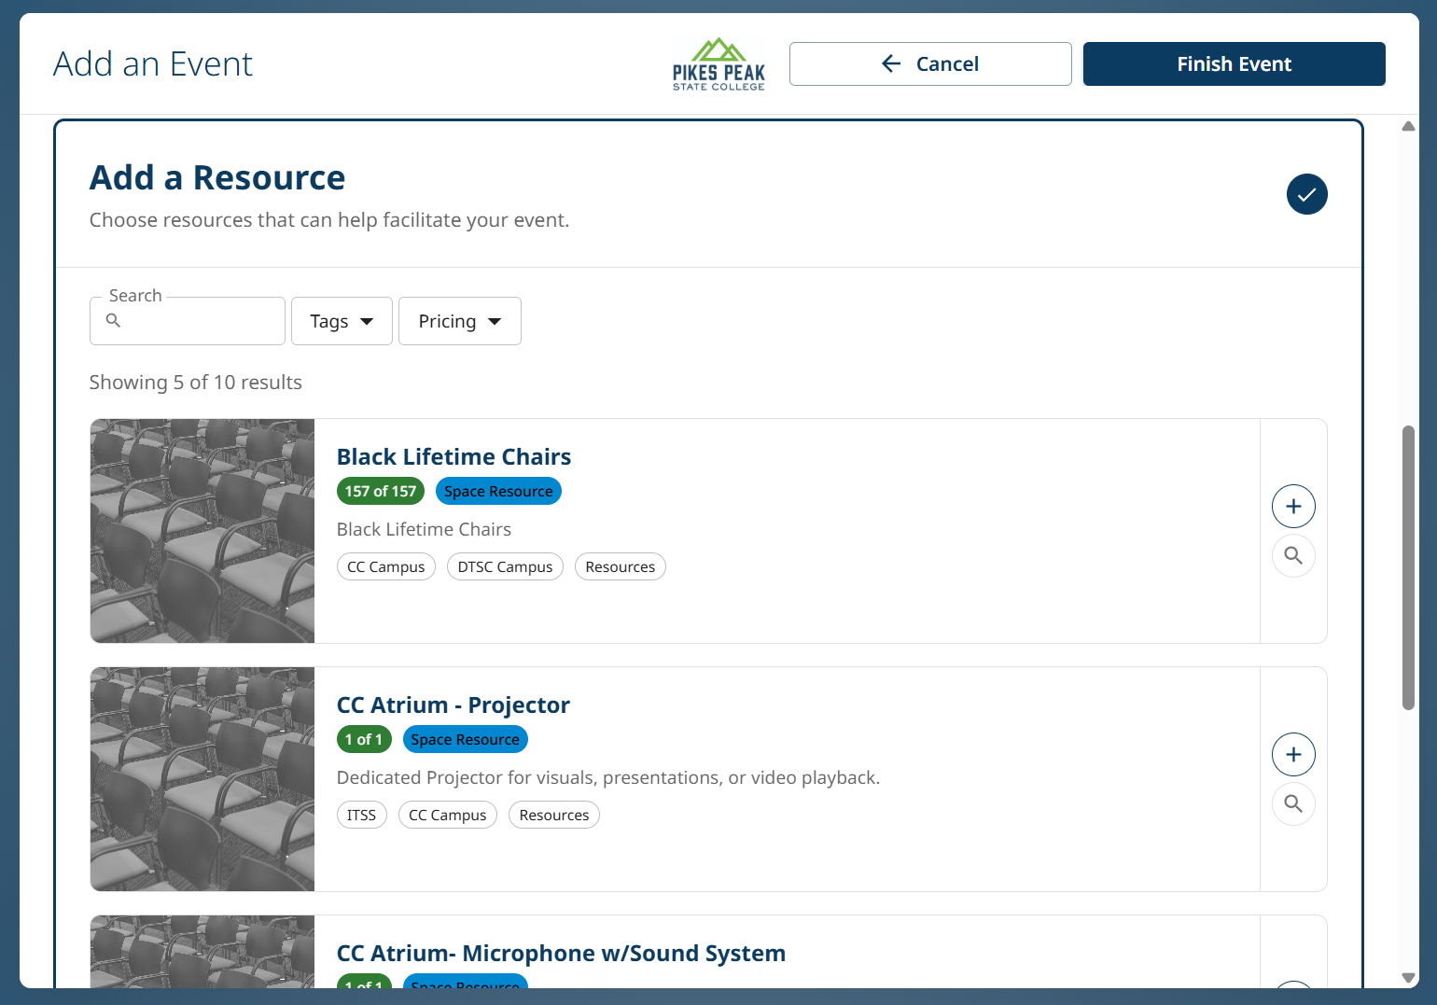
Adding an Event- Resources
Resources are Room Specific- need separate “Events” if requesting resources in more than one room
Click on Plus Button on right side of Resource
Choose Total Number of Resources Requested
EventsManagement@pikespeak.edu email to edit or add resources after request is submitted

Slide 12
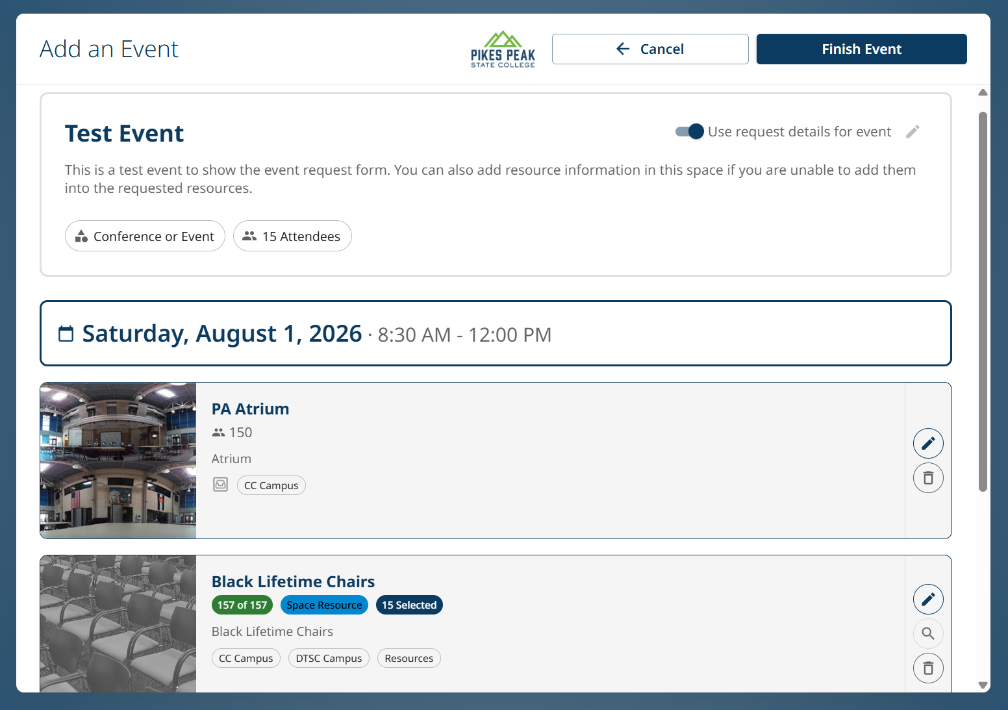
Finalizing Request
Date/Time, Location, and Resources on request will show here.
Can still edit and add more
Click “Finish Request” button once you verify information

Slide 13
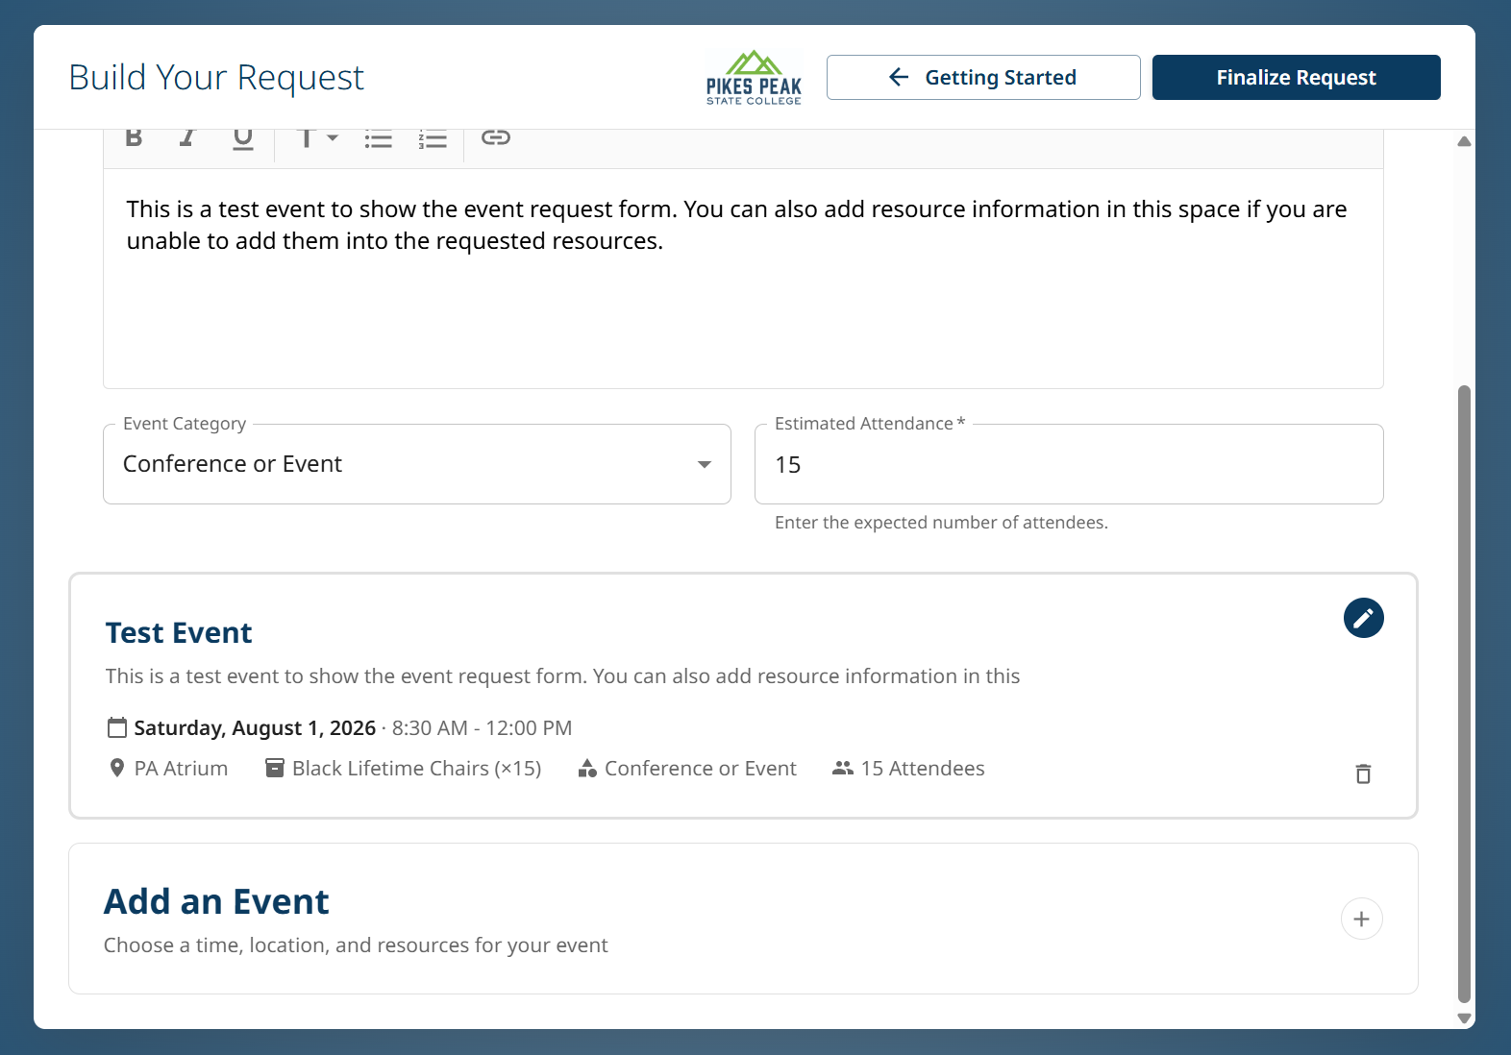
Finalizing Request
Edit any information on ticket- can add more information in description
Separate “Events” on the same request are needed if booking a main space (i.e. Atrium), along with breakout rooms
“Add an Event” at the bottom can add another request in AdAstra

Slide 14
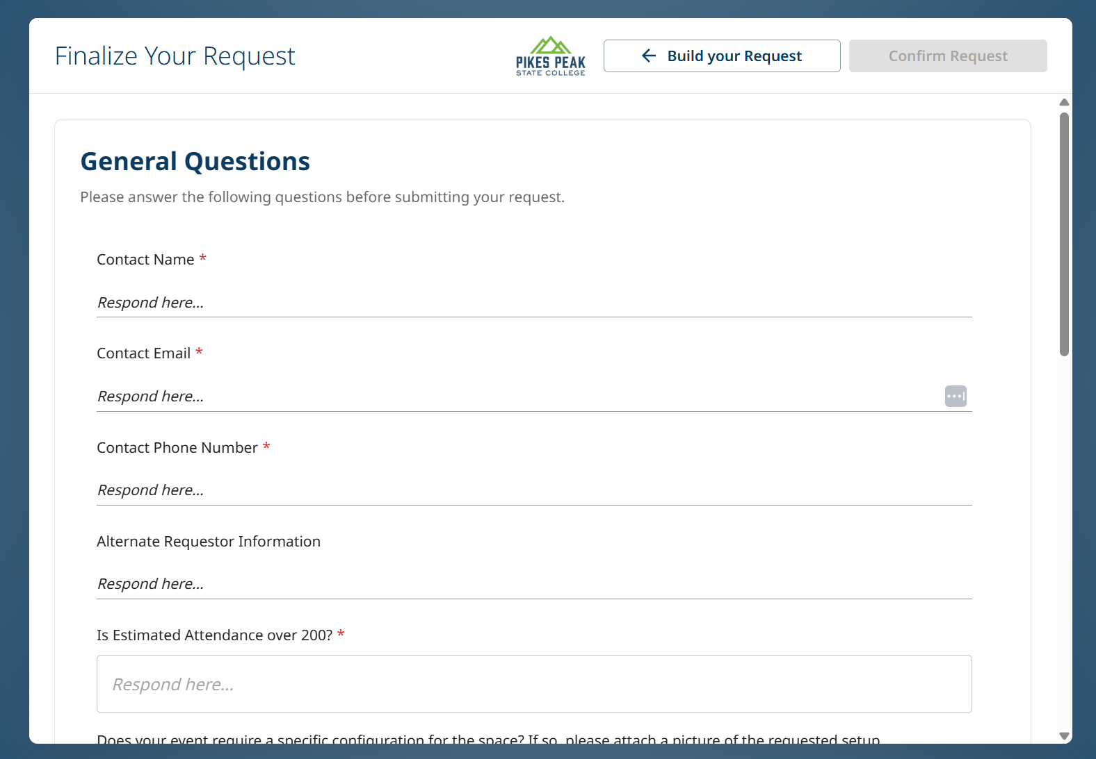
Finalizing Request
General Information Questions at top
  If submitting for someone else, you can enter their contact information here
Additional Information
  Last chance to put in any resources or setup information
Can attach setup photos of space

Slide 15

Large Event/Conference
For Events using Large Event Spaces and Breakout Rooms
  Split up Rooms (Add an Event)
  If adding resources to one space, separate from the other locations
Will show as separate sections in Event Summary
Easier for IT and Facilities to know when/where resources are going
Demonstration will follow!

Slide 16
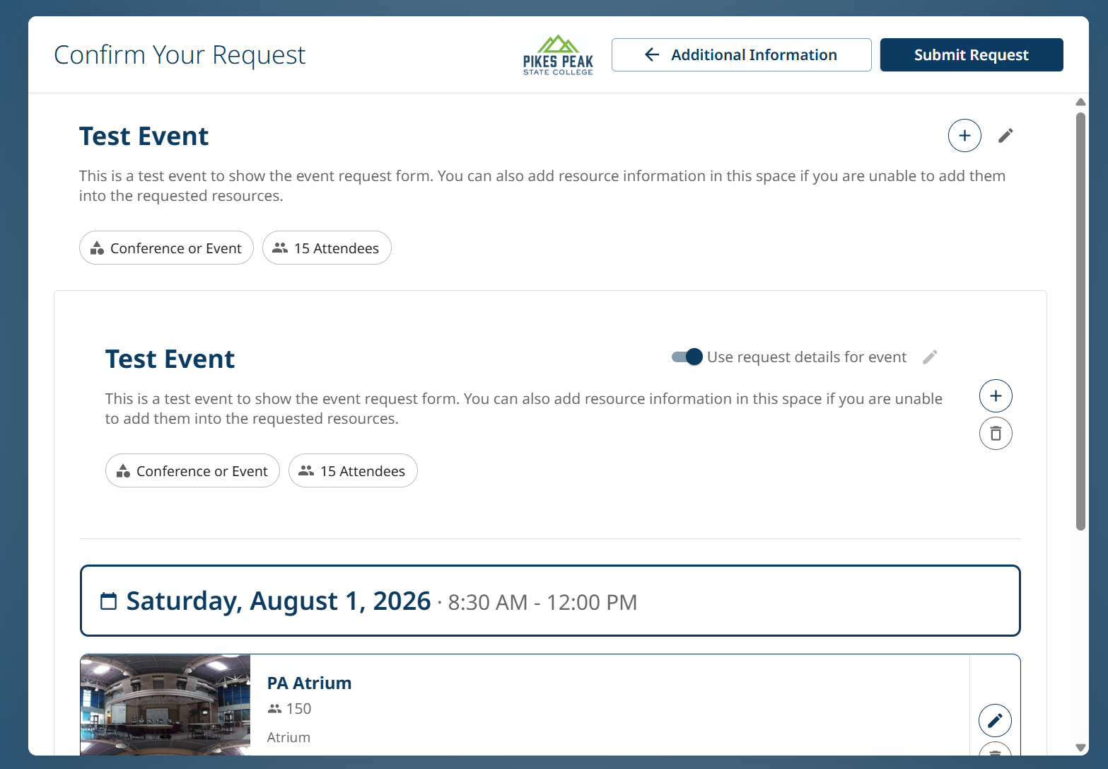
Submitting Request
Comprehensive Summary of all rooms and resources for request
Click “Submit Request” button top-right to fully submit

Slide 17

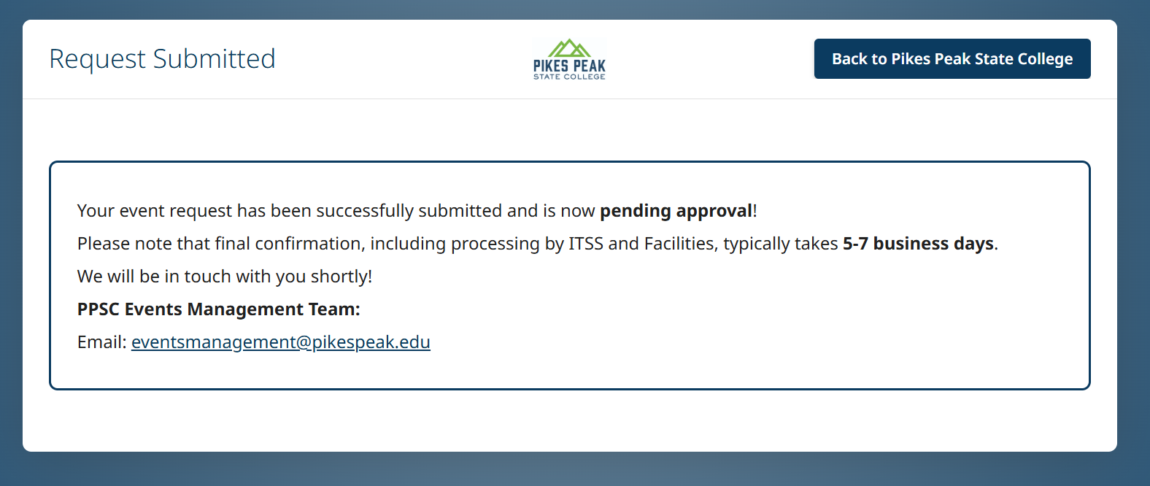
Confirmation of Request
Once you see confetti and this confirmation screen below, your event has been sent to AdAstra
Requester will receive confirmation email

Slide 18
Large Event Request Form Demonstration

Slide 19
What Happens after the Event Request is Submitted?
Events Management will audit the request
  Add additional resources from comments
  Request Approval from Space Owners
  Notify ITSS and Facilities of Resources Requested
Requester will receive email notifications when Room, Resources, and Event are approved
Events Management will reach out to the requester (or alternate requester in notes) with any questions

Slide 20
What Events Management Does Not Do
Submit an Event Request on your behalf from a Teams Message, Phone Call, or Email
Conference Rooms (i.e. A140 at CC)
  Booked through the Conference Room’s Outlook Calendar
  Events Management does not have access to all reservations on Calendars
Plan your event
  Can help find available rooms for events!
Submit a Publicity Request For your Event
  These will need to be submitted normally through the Publicity Request Form

Slide 21
Need to Edit, Cancel, or Update an Event Request?
Email EventsManagement@pikespeak.edu referencing the day, time, location, and name of the event
  Can also include Request ID from confirmation email
If Facilities and ITSS receive a ticket for an event they do not have on their calendar, they will close the ticket and send you to Events Management
If you need to cancel your event, email Events Management, and we can alert IT or Facilities of resources no longer needed.

Slide 22
Recap
Submitting the Event Request Form
  Include as much information as possible on the request
  Have some ideas about rooms/resources before submitting the event request form
  Verify Resources at least 2 weeks out
  Split up Request if using resources in specific rooms
EventsManagement@pikespeak.edu
Events Webpage

